Slide 1



Making Flexible Working
the Default
Claire Campbell
Director of HR Research and Consulting
Claire.Campbell@employment-studies.co.uk
@clairecampbellj

Slide 2
Aims for Today
Growth of demand in flexible working
Current proposal for consultation
Barriers and opportunities for employers
Innovations in job design

Slide 3

“Flexible working” describes a type of working arrangement which gives a degree of flexibility on how long, where, when and at what times employees work.’
CIPD, 2019

Slide 4
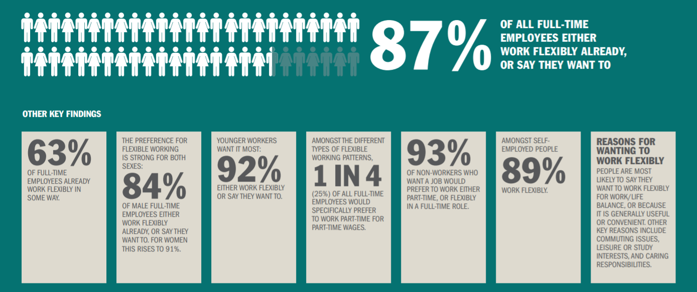
Demand for flexible working
The Talent Imperative, Timewise 2017

Slide 5
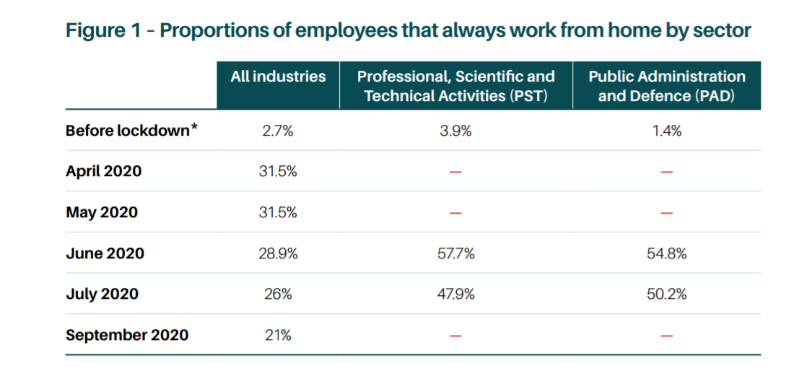

Growth of homeworking

Slide 6
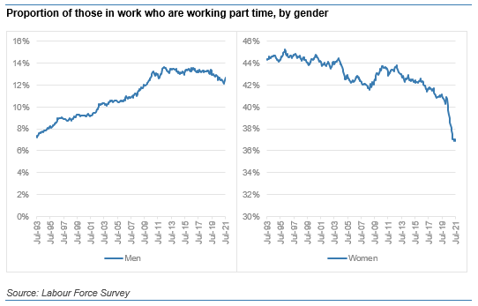
Reduction in part time working

Slide 7
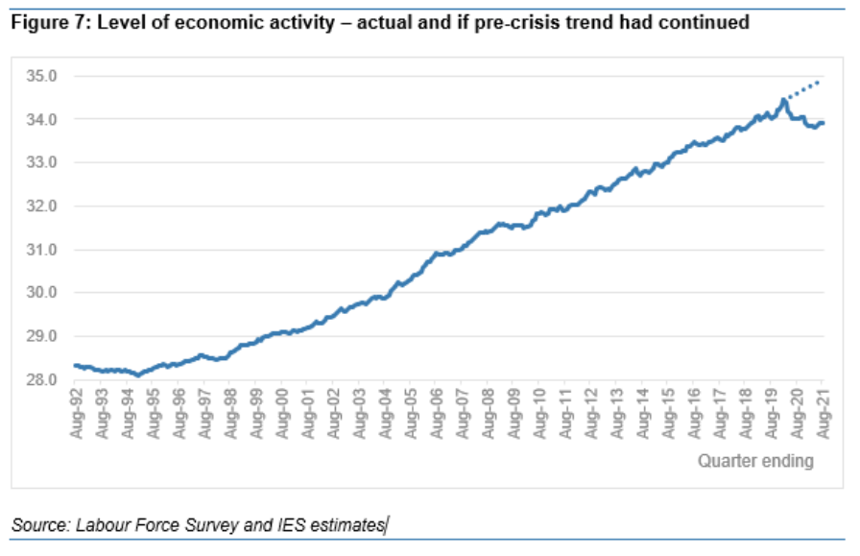
Smaller workforce

Slide 8
So why now?
Limited evidence that right to request has worked
  % who have no access to flexible work has only dropped 4%
  Still less than 20% of job adverts reference flexible working
Growth in demand post lockdown
Hard to prove it can’t work
Access to work for key groups
Talent and skills shortages

Slide 9
So what is the current legislation?
Right to request after 26 weeks
One request each year
8 reasons to reject applications

Slide 10
Reasons to reject requests
extra costs that will be a burden on the business
the work cannot be reorganised among other staff
people cannot be recruited to do the work
flexible working will negatively affect quality
flexible working will negatively affect performance
the business’ ability to meet customer demand will be negatively affected
there is a lack of work to do during the proposed working times
the business is planning structural changes.

Slide 11
Current consultation
Right to request from day one
Whether the 8 reasons are still valid
Requiring employers to present alternative options if possible
More requests each year
Able to grant temporary requests

Slide 12
Breakout Discussion
What are your views on the proposed changes?
Do you think the ask is fair of employers? Big and small?
Does it go far enough?

Slide 13





So who is being proactive on flex working?

Slide 14
Thinking differently…
Design of work
Use of workspaces
How technology can support

Slide 15
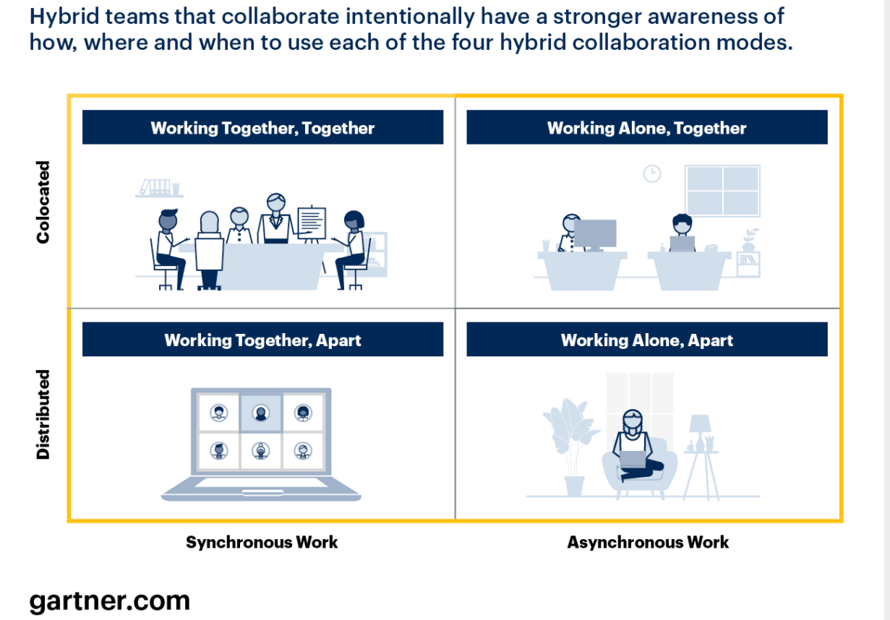

Slide 16
Where to start….
Work with managers to identify and co-design the options which could work in their team
Be specific in your job adverts about the flex you can offer
Think about where your future workforce will come from and what they will want from work

Slide 17
Further reading
Government Consultation (til 1st Dec)
https://www.gov.uk/government/consultations/making-flexible-working-the-default
Who wants to work flexibly stats (2017)
https://timewise.co.uk/article/flexible-working-talent-imperative/
Follow our current project on how lockdown is changing work
https://www.workafterlockdown.uk/

Slide 18


About IES:
The Institute for Employment Studies (IES) is an independent, apolitical, international centre of research and consultancy in public employment policy and HR management. It works closely with employers in all sectors, government departments, agencies, professional bodies and associations. IES is a focus of knowledge and practical experience in employment and training policy, the operation of labour markets, and HR planning and development. IES is a not-for-profit organisation.
www.employment-studies.co.uk
Follow IES on Twitter @EmploymtStudies
and LinkedIn Institute for Employment Studies

