Slide 1



Recovering from Covid-19
Key challenges and what we do about them
Tony Wilson
Director, Institute for Employment Studies
Tony.Wilson@employment-studies.co.uk

Slide 2
But instead are facing three, linked challenges
We avoided an unemployment crisis…
A weak employment recovery – as Darren says, driven by fewer people in the labour force
Labour and skills shortages – due to smaller labour force but also industrial change and people moving jobs
Costs of living crisis and recession – that will get worse before it gets better
Likely to be lasting changes – or at very least, to have lasting impacts

Slide 3
Where have all the workers gone?
1. Weak employment recovery
I agree with Darren! Older people, ill health, students are key
Can also think about this in terms of flows – into and out of work
Most focus (as always) has been on people flowing out – especially retirement…
But bigger impacts are from lower flows into work – due to:
Ill health – people staying out of work longer
Studies – young people leaving education later
Migration – fewer people coming from overseas to fill jobs

Slide 4
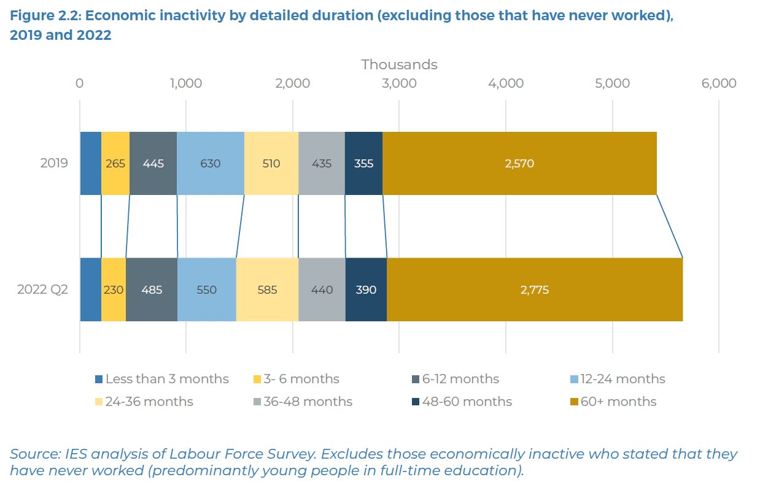

We can see this most clearly in durations since last worked…

Slide 5
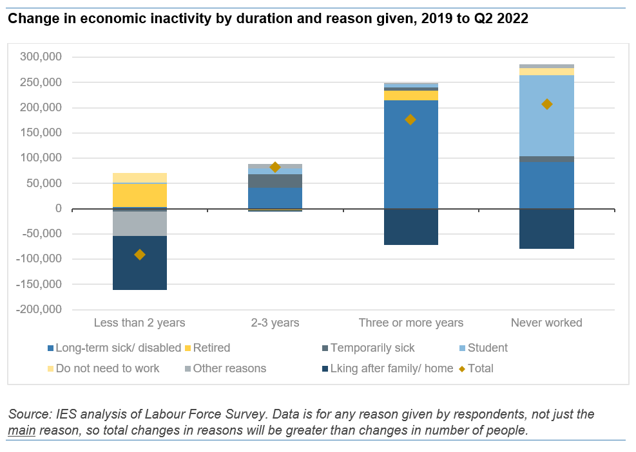
… And in reasons for economic inactivity (including here those who’ve never worked)

Slide 6
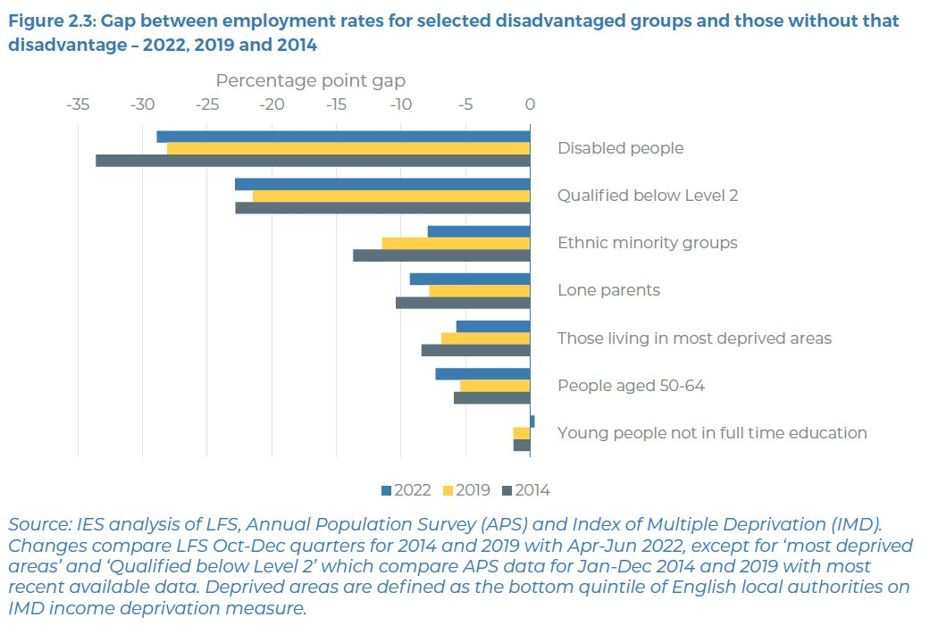
Employment ‘gaps’ widening after decade(s) of improvement
With those most disadvantaged faring worse

Slide 7
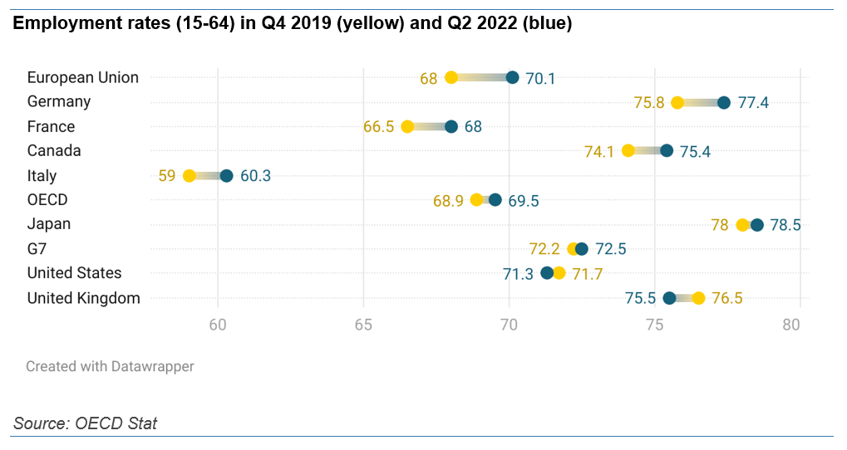
Worst recovery in G7, among the worst in the entire (developed) world
This really isn’t happening in other countries

Slide 8
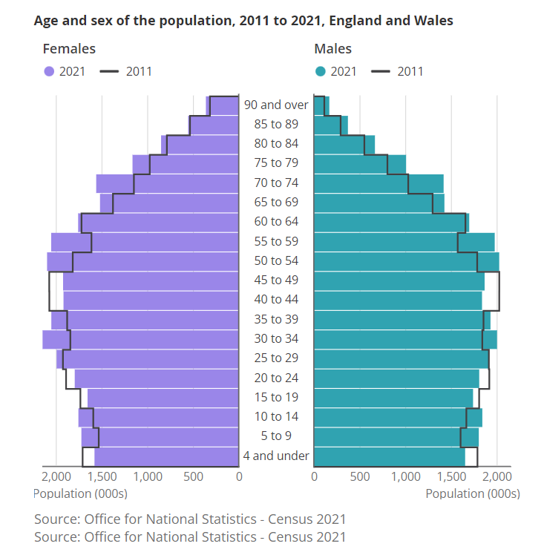
1. Ageing: Baby Boomer ‘bulge’ will work through over next decade
Reasons to be pessimistic

Slide 9
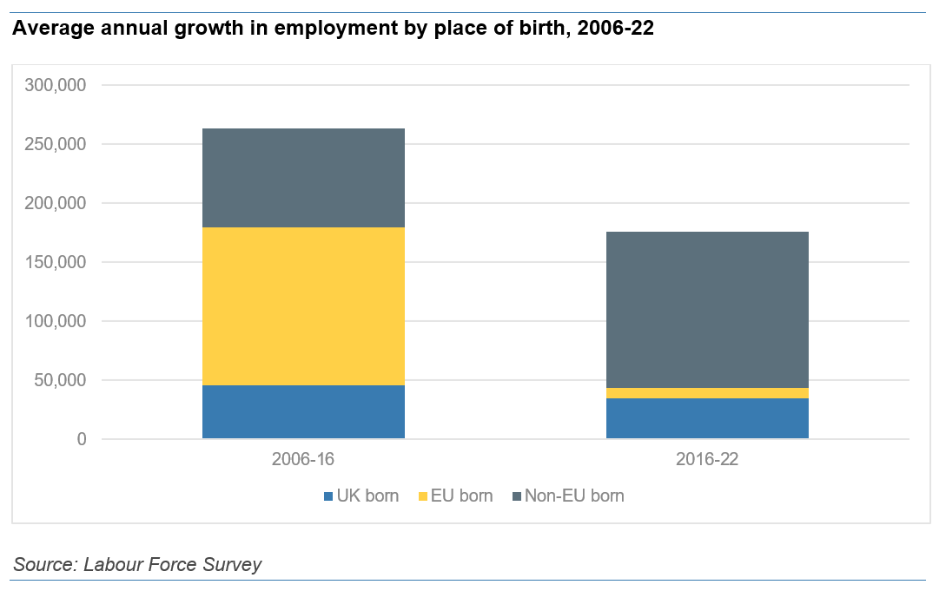
2. Migration: Growth in non-UK born workers ~80k lower per year than pre referendum
Reasons to be pessimistic

Slide 10
People would consider working in future
But reasons to be optimistic?
Nearly three quarters of those in their 50s who left during the pandemic would consider coming back for the right job
The ‘want to work’ figure in LFS only tells part of the story - many plausible reasons why more of those out of work may not want a job “at the moment”

Slide 11
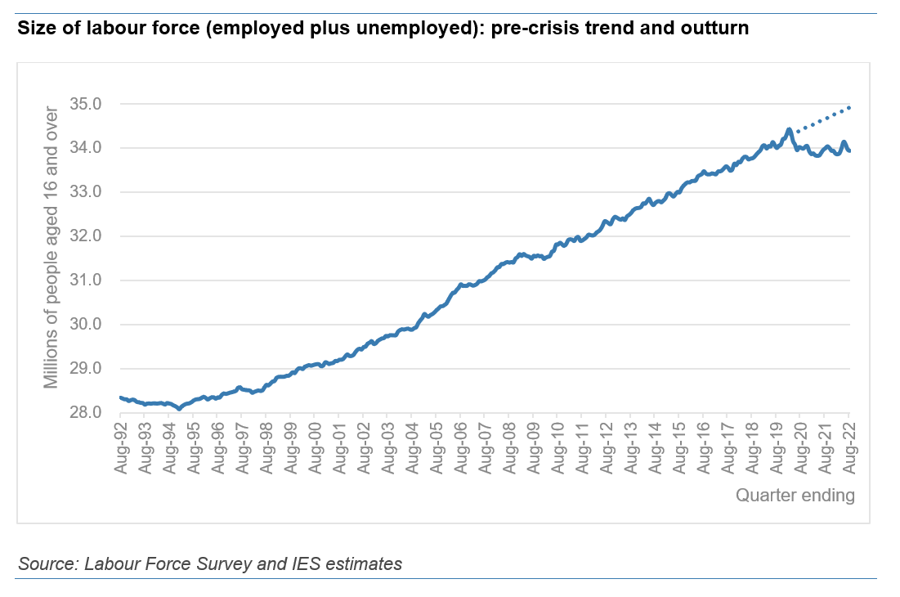
Our economic model has been based on ever higher labour supply…
2. Labour and skills shortages

Slide 12
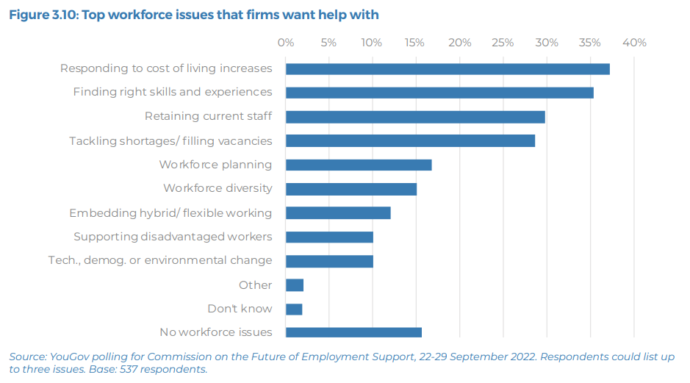
After costs of living – it’s skills, then retention, then labour shortages
Employers tell us that these are top issues

Slide 13
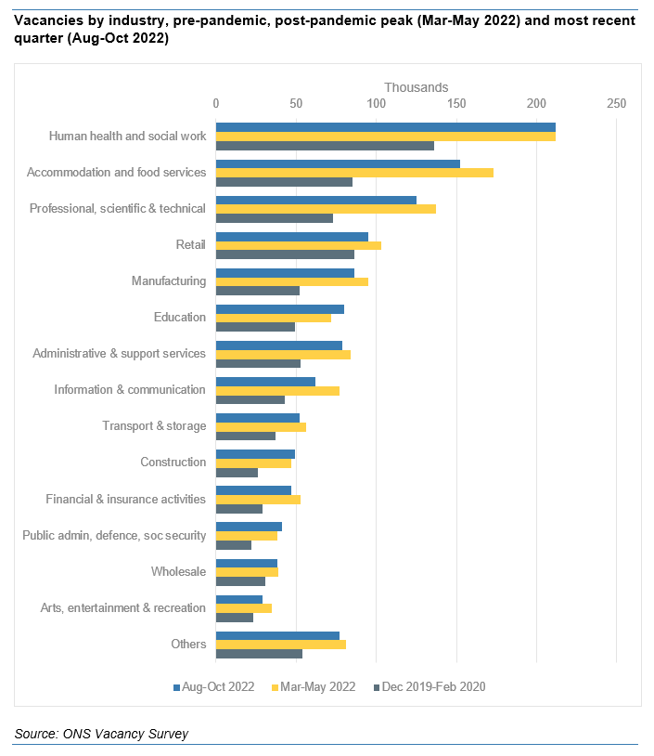
With some different factors driving different trends, as Darren suggests
Shortages are happening everywhere – across industries

Slide 14
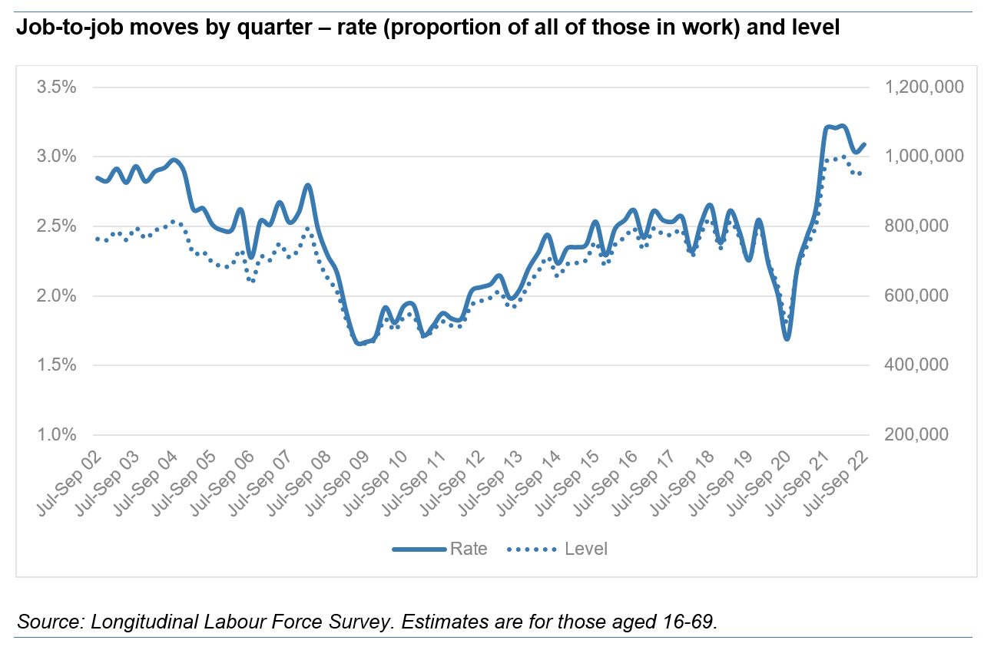
And this is where lower flows into work is felt most keenly
Really high turnover is key

Slide 15
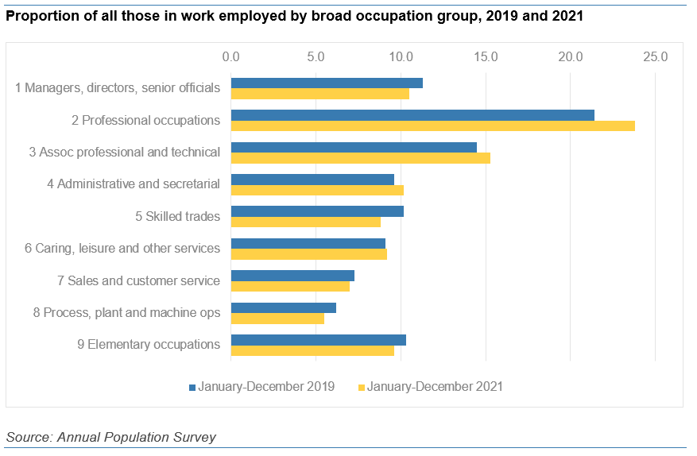
Acceleration of shift into higher skilled work
As are occupational changes

Slide 16
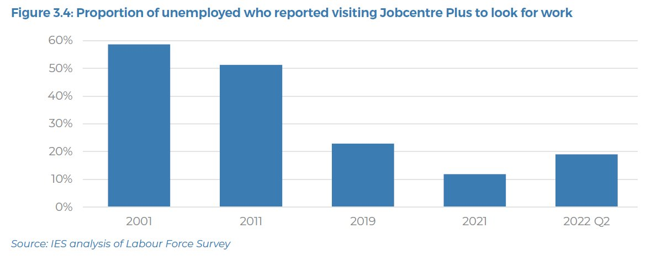
Not enough people are accessing support
Looking at JCP use specifically, just one in five of the unemployed now use it to look from work – down from half a decade ago
(And virtually none of the ‘economically inactive’ are supported via JCP)

Slide 17
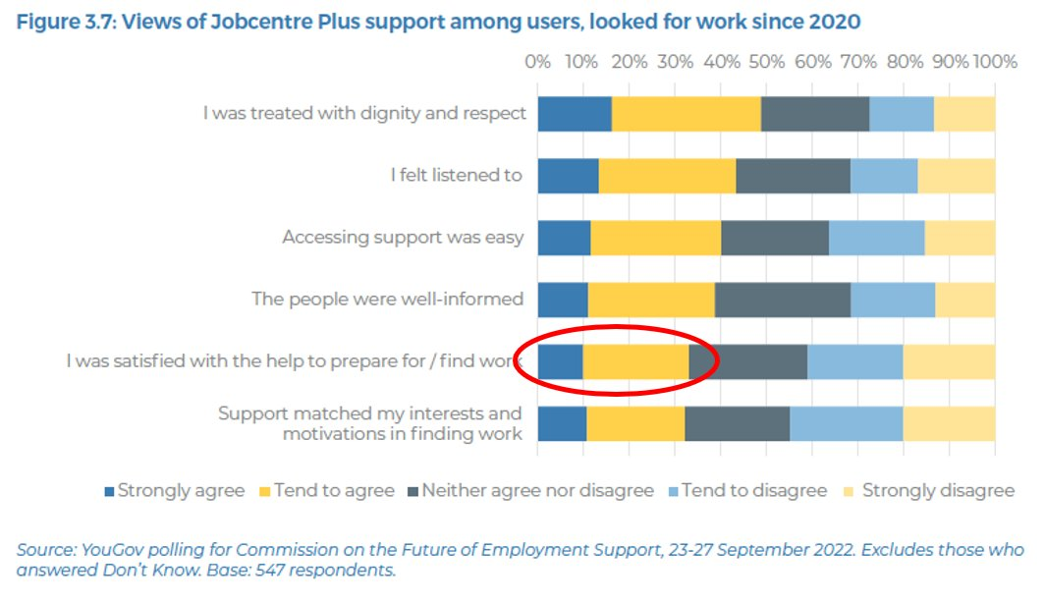
Generally positive about how they’re treated, but just one third find the support helpful in preparing for or finding work
While those that do use JCP have mixed views

Slide 18
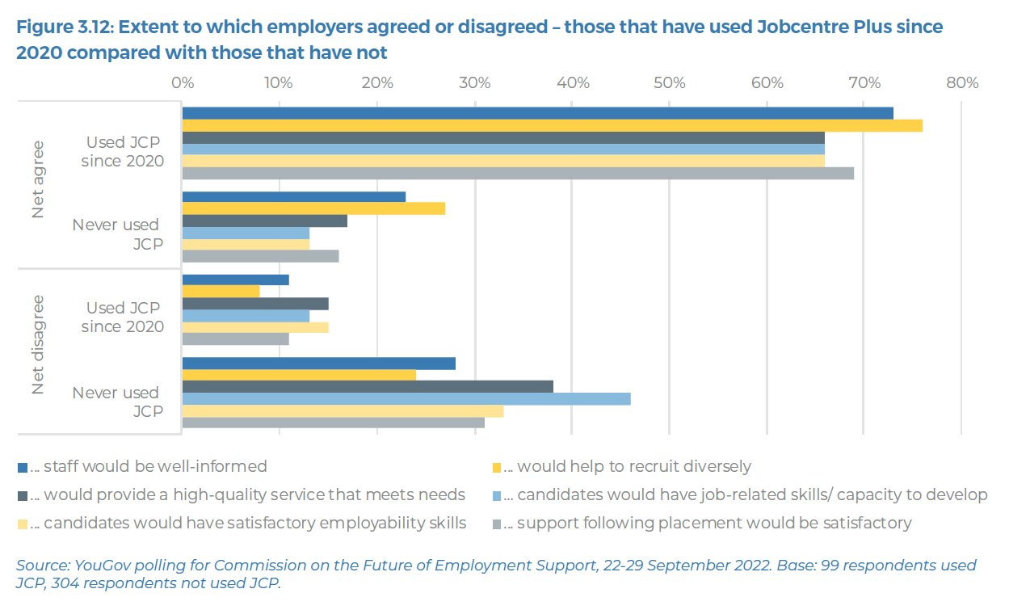
Those that use it are very positive, but those that don’t aren’t
Among employers, just one in six use JCP…

Slide 19
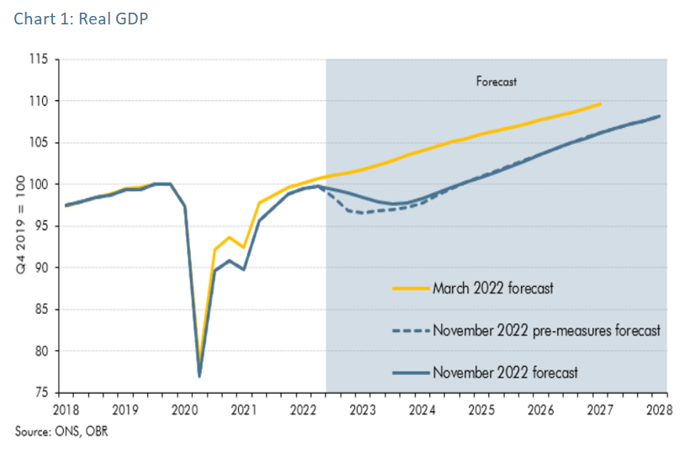
We’re heading into a long but shallow recession
3. Costs of living and recession

Slide 20
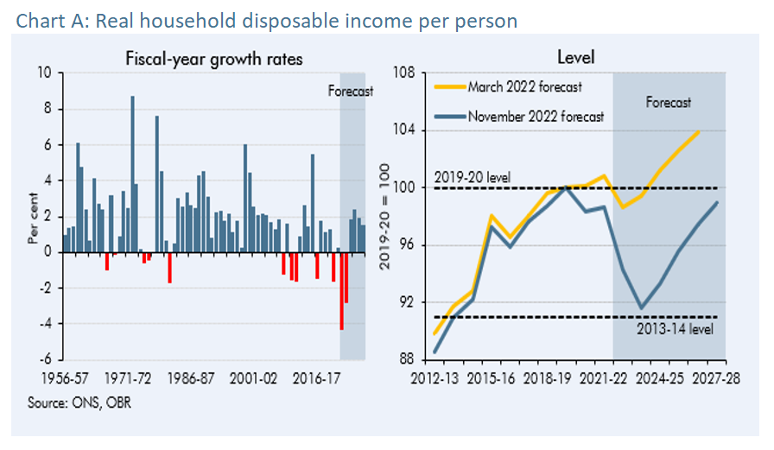
(But, savings did build up during pandemic – so future is uncertain)
Worrying impacts on household incomes

Slide 21
In theory yes, but in practice…
Will this lead to labour market loosening?
Forecasts have consistently over-stated unemployment impacts of slowdowns
The smaller labour force is not a temporary phenomenon
More likely firms will ‘hoard’ labour – so reducing hiring more than letting people go
Recessions are not always good news for skills shortages – especially if people aren’t getting the right support

Slide 22
As employers, four key themes that we’re seeing:
So… what do we do about it?!
Recruitment
Labour market intelligence, partnerships, reviewing/ streamlining processes and systems
Job design
Improving flexibility, security, line management, induction, support at work (health, wellbeing, skills, tech etc)
Support
Targeted financial assistance/ loans, better conversations at work, help to find local/ national support
Workforce planning
Lost art… Internal and external; ‘as is’ and future planning; gaps analyses, actions and review

Slide 23

www.bit.ly/employment-commission

Slide 24
Recovering from Covid-19
Key challenges and what we do about them
Tony Wilson
Director, Institute for Employment Studies
Tony.Wilson@employment-studies.co.uk

