Slide 1
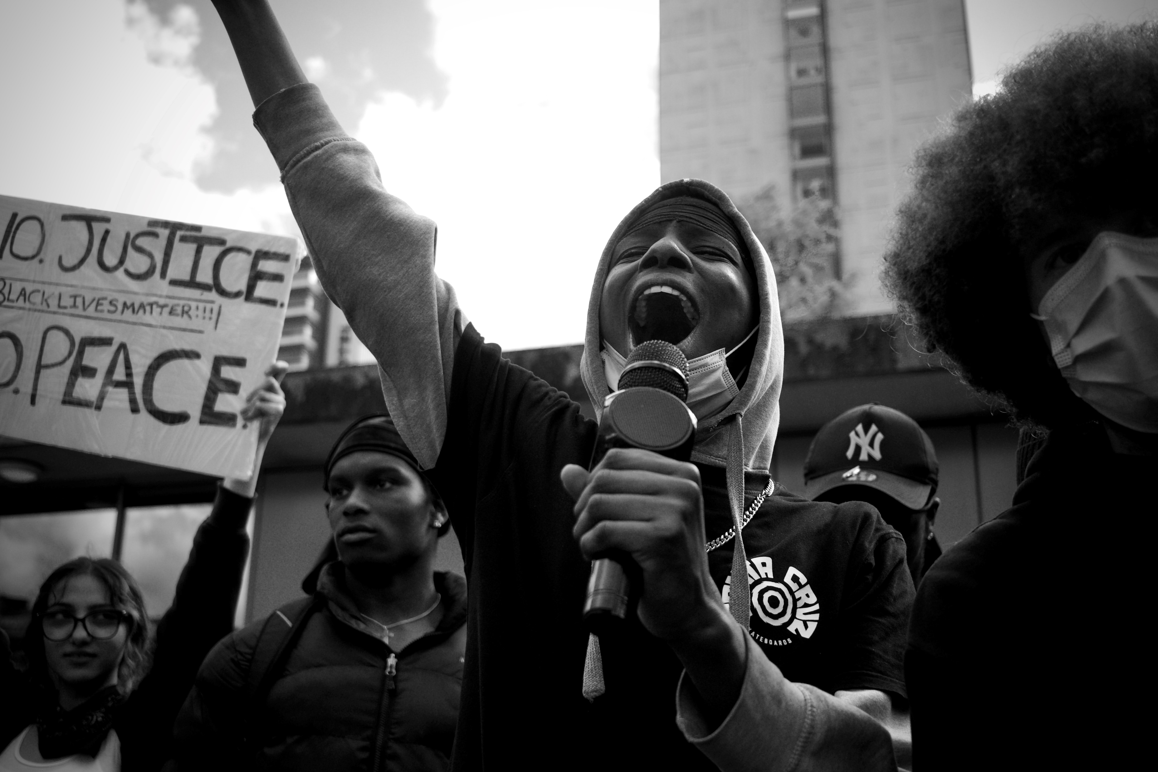
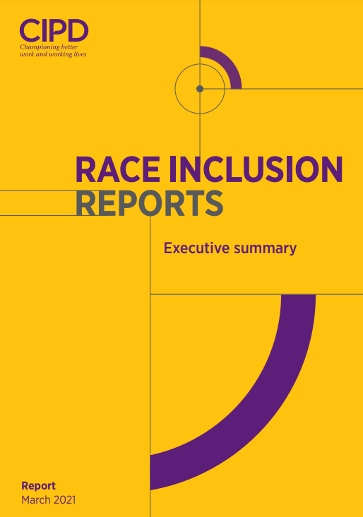
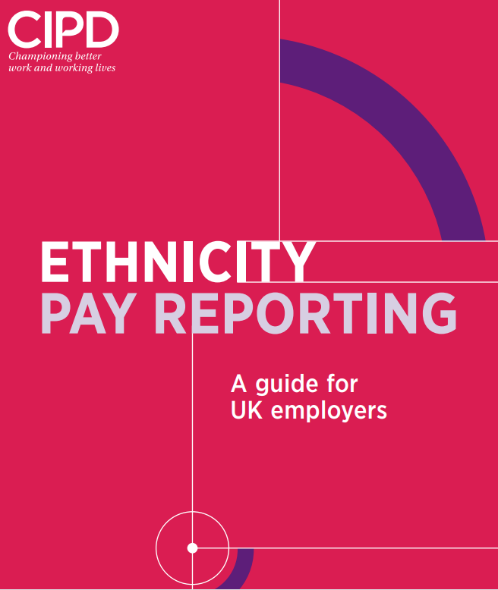
IES HR Network:
Ethnicity pay reporting
Why?
What?
How?
A Framework for Change and Genuine Racial Equality
Dr Duncan Brown
@duncanbHR
duncanibrown54@gmail.com
September 16th 2021

Slide 2
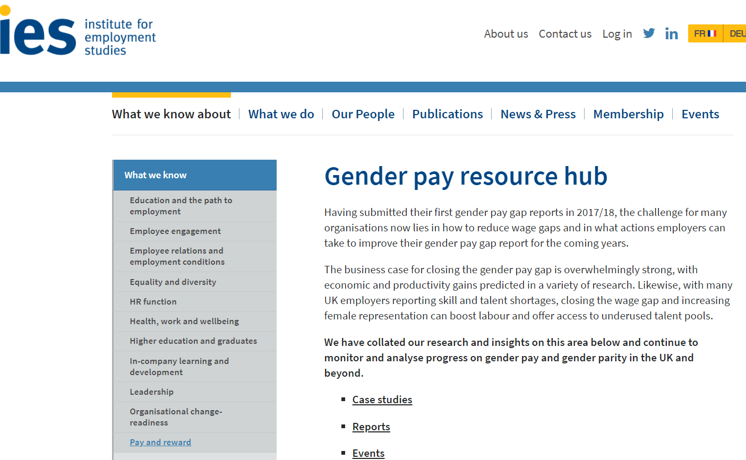
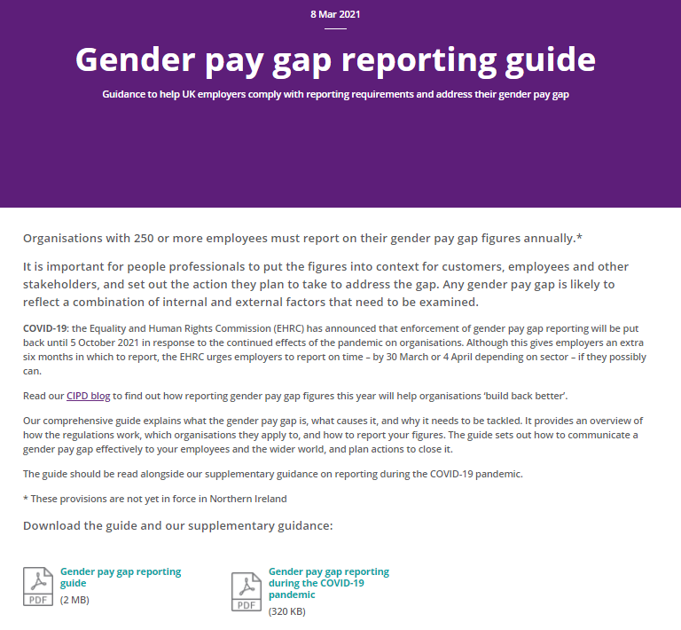
My aims and agenda this morning
‘Ethnicity pay gap reporting will help achieve equality’. Sir David Isaac,-chair EHRC, 15.6.20.
‘The CIPD has consistently highlighted the need for organisations to be more transparent about how they report on the ethnicity of their workforce… as a catalyst for creating more diverse and inclusive workplaces’. CIPD CEO Peter Cheese, 10.10.18
Make the case for voluntary reporting (even though we think it should be mandatory)
Acknowledge and outline the difficulties
Outline a framework for how to do it and provide resources to help
Explain and discuss how to use it to drive racial equality

Slide 3
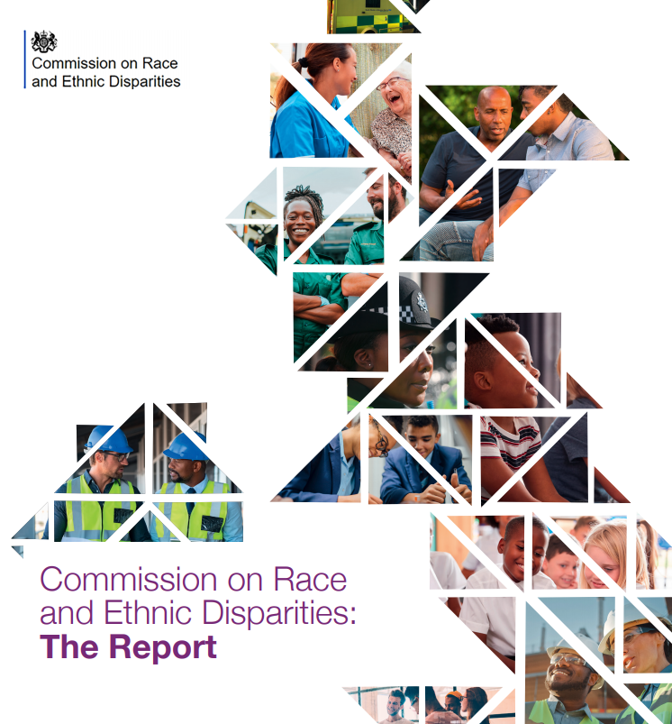
This has become something of a politicised and contentious area
Who do you believe?
Ethnic minorities are also now well represented in the highest social class and ethnic minority students represented nearly a quarter of those from the UK offered a place at Oxford
.. in addition, our enquiries have also underlined to us that the roots of advantage and disadvantage for different groups are complex, and often as much to do with social class, ‘family’ culture and geography as ethnicity

Slide 4
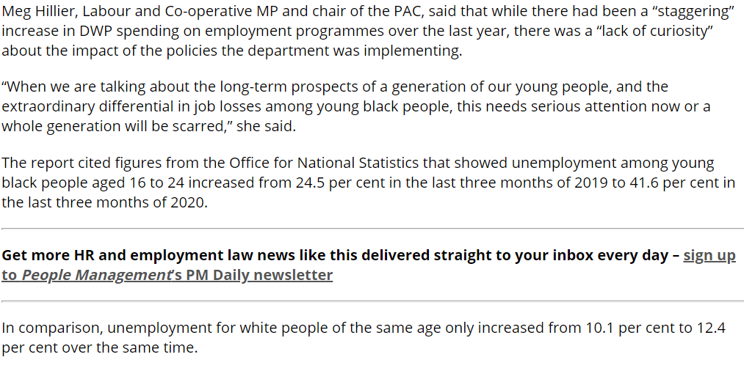
…0r ?
Black women junior surgeons were 42 percentage points less likely to be promoted than white men, while women of Indian and Pakistani ethnicity were 28 percentage points less likely to be promoted.

Slide 5
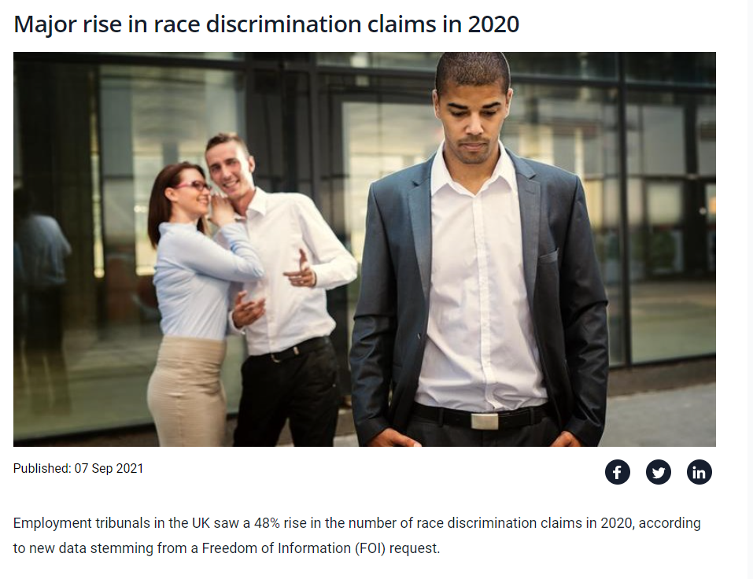
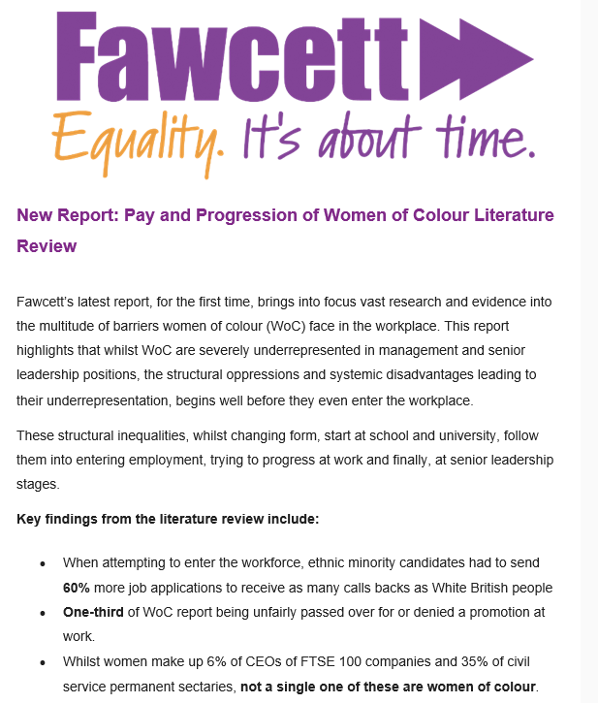
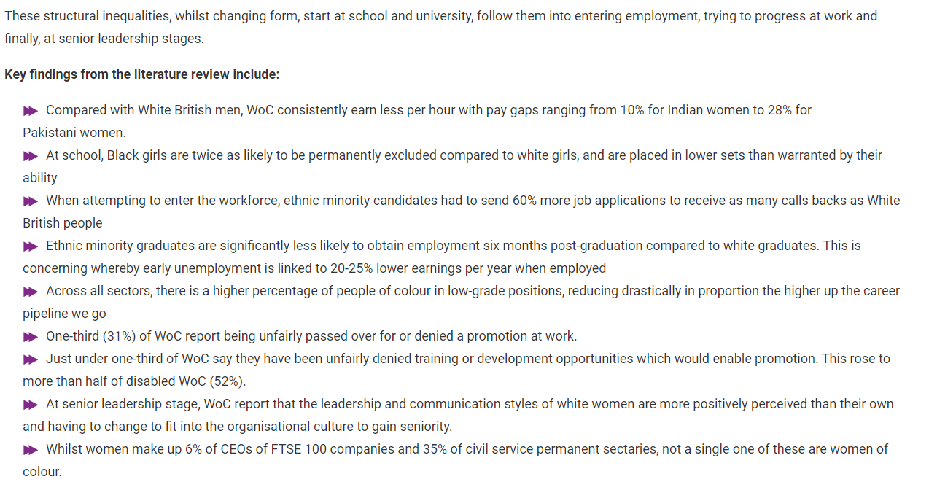
.. Or perhaps?

Slide 6
Why is it important, why should I do it?
Shocking levels of racial inequality
Revealed and deepened by Covid-19…
Driving social movements & change - Black Lives Matter
Addressing the HR ‘say/do’, ‘rhetoric/reality’, policy/practice gap
Strong moral, economic, business case
Its bloody unfair!
- ‘Most of the minority ethnic groups analysed continue to earn less than White British employees in 2019’, (ONS, 2020)
- ‘A £3.2 billion pay penalty’ TUC

Slide 7
Why?
Shocking levels of racial inequality
Existing pay and wealth gaps
‘There is a wealth of evidence that UK society is unequal in terms of the educational outcomes, career opportunities and pay for people from different ethnic groups’. CIPD Race Inclusion Guide
Revealed and deepened by Covid-19…
‘The pandemic has shone a spotlight on the racism faced by BME workers around the country’ TUC.
IES analysis: ‘low-income workers are bearing the brunt of the pandemic… more likely to be women, lone parents, from ethnic minority groups…no qualifications’
Ethnic minorities generally over-represented in low-paid occupations - care, sales, catering, hairdressing, textiles and clothing manufacturers.
Commons WEC ‘disproportionately badly affected’. Risk of death for black men from Covid x2 white, higher unemployment, refused a pay increase/promotion, etc
Sir Michael Marmot (Dec 2020) ‘Inequalities in health and the social conditions that lead to ill health have been amplified by the pandemic… the normal in February 2020 is not acceptable moving forward’

Slide 8
Why?
‘The level of scrutiny about how businesses act has been heightened through the crisis. While COVID-19 has impacted all of us, it has not impacted us all equally…Have D&I efforts just been scratching the surface, applying sticking plasters to wounds on racism that we haven’t understood? Has the diversity agenda not really been central to the business agenda? Or has it been a case of complacency or discomfort in dealing with ‘inconvenient truths’?’ Peter Cheese
…Driving social movements & change - Black Lives Matter
Growth of ESG investing and ‘ a new era of corporate transparency’ eg Goldman Sachs leadership
Address the HR ‘say/do’, ‘rhetoric/reality’, policy/practice gap
The CIPD anti-racism strategy: ‘employers need to maintain a zero-tolerance approach to workplace discrimination – as is required by the Equality Act 2010 – and commit to planned action’.
‘The solemn declarations of intent and solidarity that flooded from corporations and governments will leave us drowned in a sea of racial sensitivity training unless they are followed up by thoroughgoing change and investment to genuinely tackle inequalities’ Gary Younge Waking up to the Realities of Racism in the UK
Experience of Gender pay reporting
‘The Gender Pay Gap Reporting Regulations have driven an important national debate on fairness at work, amplified now by the unequal health and economic impact of the pandemic on… ethnic minorities’ EHRC
Driven actions to close gap
Dropped when compulsion removed last year
Strong moral, economic and business case
6% of top management positions were held by people from BME backgrounds (2017);
52 of 1,099 most powerful roles in UK people from ethnic minority background (2020), up 1.2%.
McKinsey in their 2020 report, ‘Diversity Wins: How inclusion matters’ show huge economic returns and ‘the likelihood of outperformance continues to be higher for diversity in ethnicity than for gender’.
Growing appetite for change - over 500 signatories to the Race at Work Charter, more than 130,000 signatures to 2020 petition for mandatory ethnicity pay gap reporting

Slide 9
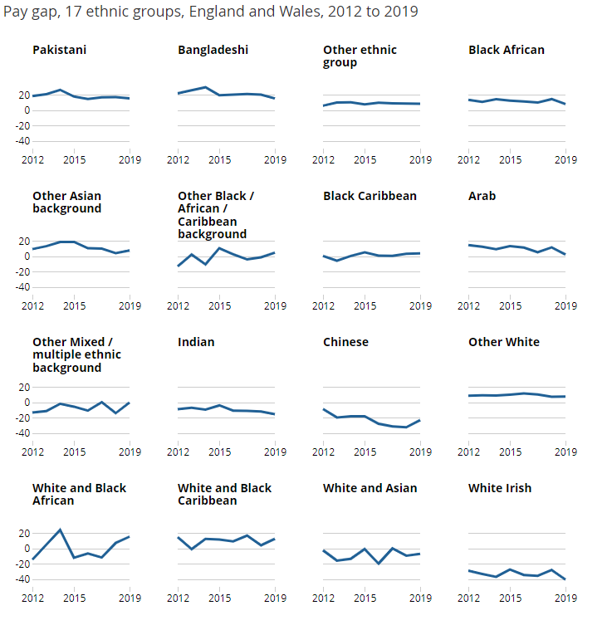
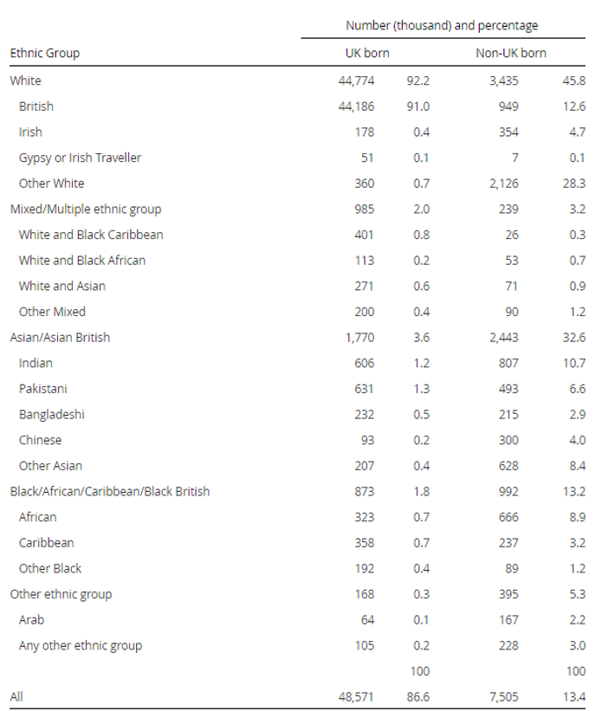
What?
Now for the difficult part…
(Source: ONS, 2020)

Slide 10
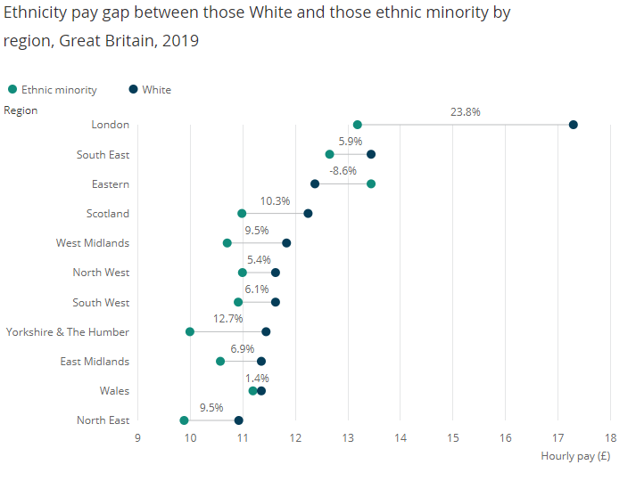
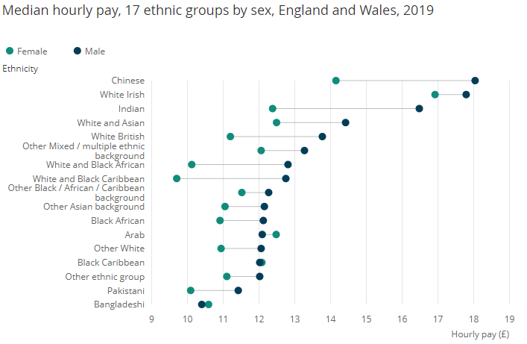
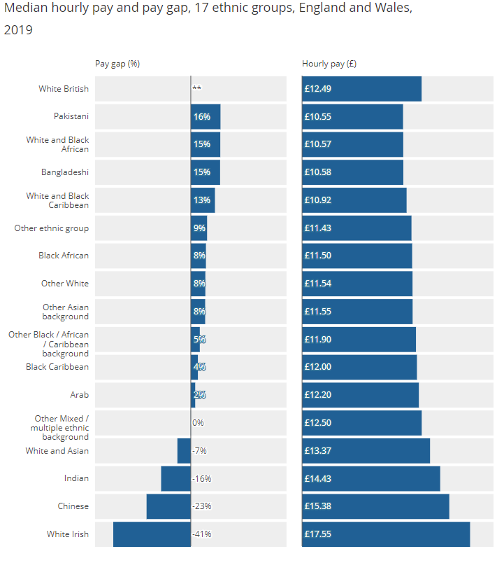
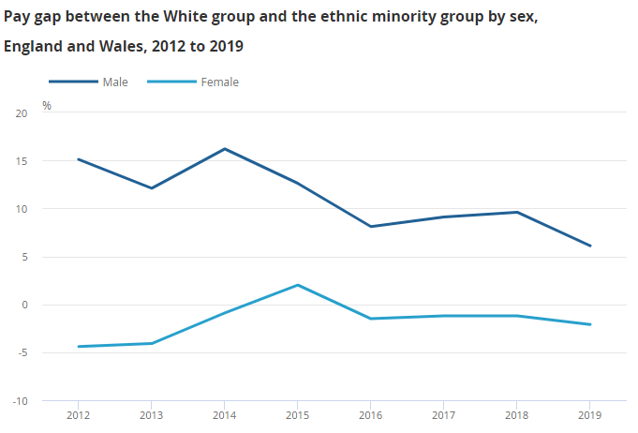
What: Widely varying pay levels and intersectionality: what is ‘good’?

Slide 11
Other issues
CIPD’s consultations with employers and HR leaders in late 2018 found:
‘A consensus about the much greater complexity of the issues as compared to gender. Employers reported currently having much poorer data than they did for gender, and also variations in the categories used for internal data monitoring. As with disability, staff can be reluctant to provide this information for fear of how it will be used. Employers agreed that there was a much greater cultural obstacle to overcome, more reluctance to engage with discussion about ethnicity in the workplace’.
Representation levels, internally and externally
Data and disclosure rates: Holding ethnicity data is not currently a legal requirement for employers
Greater reluctance and discomfort with discussions on ethnicity and ethnic discrimination, compared to say gender. 33% of the CIPD survey respondents, have talked about race at work; only a quarter said there is specific employer support for conversations about ethnicity, for example via an employee network group.
Uncertainty around language and terminology which stops people from having conversations about race according to 32%.
All of the gender pay reporting issues – pay definitions, treatment of shares and benefits, agency workers, salary sacrifice, etc,
IES observe, ‘the need to make reporting compulsory rather than voluntary, but also the distance which many employers will have to travel in order to get their data collection and statistical analysis into a fit state to report on. In our view this will require more time to prepare for these changes, and more support for employers’

Slide 12
How? Six core principles
Align EPR as far as possible with gender pay reporting…. but recognise that they are not exactly the same.
Ethnicity representation is as important as, and strongly linked to, ethnicity pay gaps; so both are reported.
Simplicity and clarity are good externally, but more detailed analyses are required to support effective, targeted actions.
Comparability in data needs to be combined with tailoring of analysis and actions.
Action focus.
‘Start and improve’ evolutionary approach

Slide 13
How? The easy part -The 8 stats to publish pa
The six gender pay gap reporting stats:
Median ethnicity pay gap –the difference between the median hourly rate of pay of all white full-pay relevant employees and the median of full-pay relevant employees from other ethnic minority /BAME backgrounds;
Mean ethnicity pay gap – the difference between the mean hourly rate of pay of all white full-pay relevant employees and that of full-pay relevant employees from other ethnic minority/BAME backgrounds;
Median bonus gap – the difference between the median bonus pay paid to all white relevant employees and that paid to relevant employees from other ethnic minority backgrounds;
Mean bonus gap – the difference between the mean bonus pay paid to white relevant employees and that paid to relevant employees from other ethnic backgrounds;
Bonus proportions – the proportions of relevant employees from white and other ethnic backgrounds who were paid bonus pay during the relevant period;
Quartile pay bands – the proportions of full-pay relevant employees from white and other ethnic backgrounds in the lower, lower-middle, upper-middle and upper quartile pay bands. Also the median ethnicity pay gaps for the staff in each quartile, as many employers chose to do voluntarily for gender.
Plus two additional to ethnicity pay reporting:
The proportion of their total UK workforce who are from BAME/other ethnic minority backgrounds, ideally in the context of external demographic data/the ethnic diversity of their community (14% UK, 40% London).
The proportion of their employees who have disclosed their ethnicity.

Slide 14
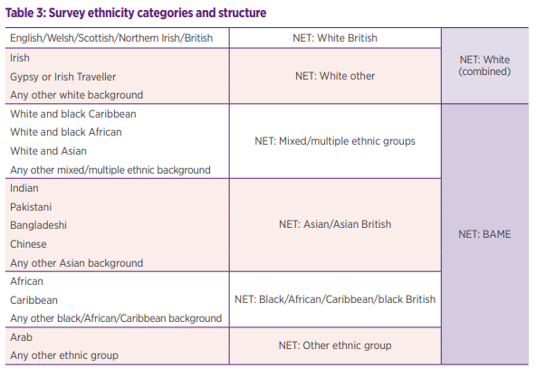
How? The ethnicity categorisations to use
All employers: White employees versus all ethnic minorities
Smaller employers additionally: the ‘five plus one’ breakdown
Larger employers additionally: the 17/18 category breakdown (already done by 50% of those reporting)

Slide 15
How? – the hard part, ACTION
‘IES believes that collecting, analysing and reporting their ethnicity pay information will help enable employers to target their interventions more effectively and create actions plans to close their pay gaps. It should help organisations to consider their causes, highlighting any relevant areas such as recruitment and promotion biases, and take steps to address them.’
‘IES Response to Government Consultation on Mandatory Ethnicity Pay Reporting’, January 2019.
‘Why capture ethnicity data? Capturing ethnicity data is important for establishing a baseline and measuring progress. It is a crucial step towards an organisation reporting on ethnicity pay differentials. Ethnicity pay gap reporting helps hold employers accountable for any disparities between different ethnic groups, draws attention to specific areas of concern, and drives a case for action to be taken to mitigate these imbalances.’
BITC Race at Work Charter Insights, February 2020.
‘Although ethnicity pay reporting is not without its challenges… we believe that ethnicity pay reporting will help shine a light on race inequalities and galvanise employer action to address these’.
CIPD Ethnicity Pay Report, 2020
More nuanced analysis and understanding of the impact of pay gaps transparency is needed. The aim of measuring pay gaps is not just to assess their size, but to understand their causes and identify potential solutions to addressing them. This understanding will support us to work towards a society in which people are not disadvantaged in terms of access to education and work opportunities’.
CBI Response, 2019

Slide 16
Treat EPR as a continuous process
Set the Aims and Scope
Gather and clean the data
Calculate the stats
Analyse causation and draft narrative
Develop action plan
Communicate, implement, monitor and review

Slide 17
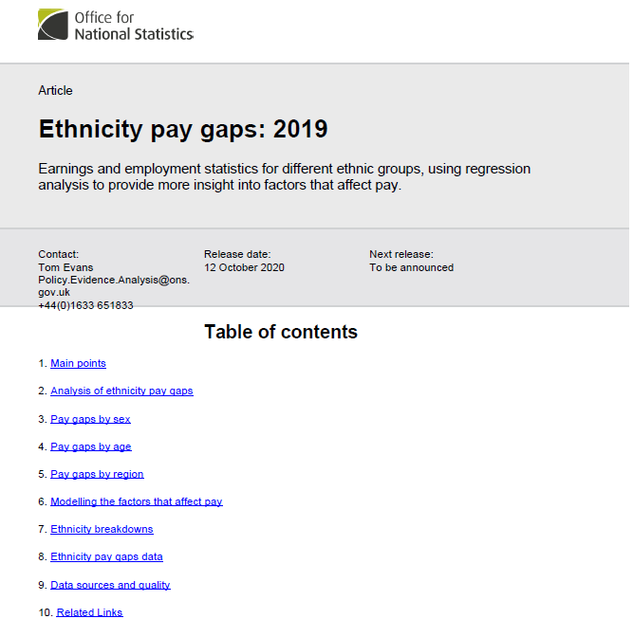
Data collection: how to improve it
Collecting ethnicity data at continuous stages throughout employment i.e. in recruitment, at induction/‘on-boarding’, annual appraisals. 78% of CIPD survey agreed that this is effective/very effective.
Consistent and regular cross-organisation communication campaigns that encourage employees to self-report their ethnicity, outlining how this information will be used to embed equality/diversity/inclusion in organisational culture
Providing different opportunities and formats for staff to provide this information and checking and updating the information on a regular basis (78% believed this would be effective)
Explaining to employees clearly the purposes for which the data will and will not be used (73% believed this would be effective - 20% extremely effective, 53% fairly effective).
Using staff networks to act as champions and information points. CIPD’s survey respondents talked about the value of using staff networks in this way and to answer any questions employees had, particularly those they may not feel comfortable asking of their line manager or HR.
CIPD’s recent survey of employee attitudes to racial inclusion highlighted the importance of trust in management and their use of this data on ethnicity, in raising disclosure rates.
While employers emphasise their employees’ reluctance, the survey found substantial majority of employees in all ethnic groups (84%) are comfortable disclosing their ethnicity to their employer, only 10% say they are uncomfortable with it.
More than half of employees report not being asked to provide information about their ethnicity. So request it!

Slide 18
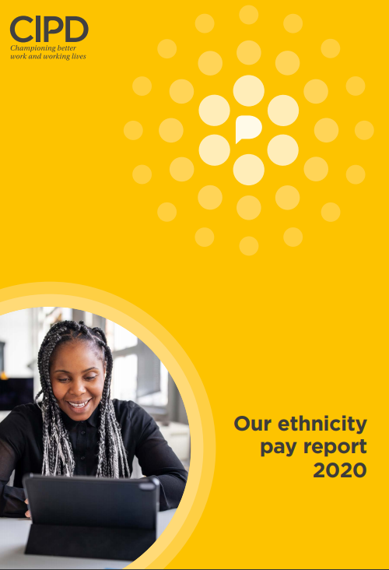
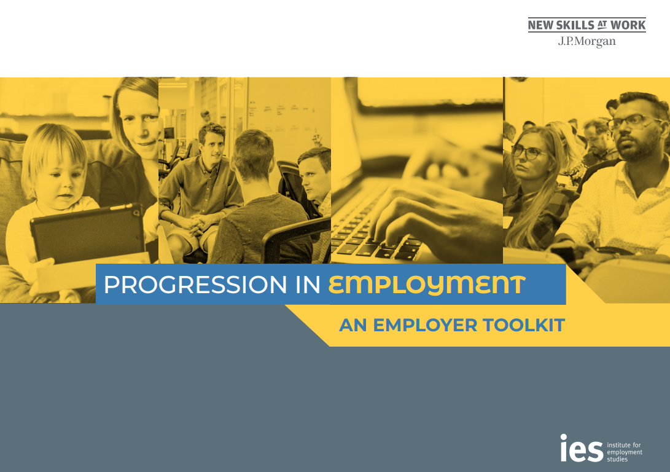
Actions: what we know
HR focuses most on training/voluntary/soft initiatives that have a questionable impact on equality and pay gaps
A broad range of initiatives across a full range of HR/employment areas for a sustained period is most effective
Include ‘hard/compulsory’ initiatives - ‘Rooney rule’ ; ‘blinder’ recruitment, salary history bans
EHRC recommendations:
1. Address differences in subject and career choices, educational attainment and access to apprenticeships.
2. Improve work opportunities for everyone, unemployment rates vary significantly by ethnicity
3. Make jobs at all levels available on a flexible basis, encourage sharing childcare responsibilities.
4. Reduce prejudice and bias in recruitment, promotion and pay decisions.
5. Report on progress in reducing pay gaps.
IES Research: Pay reporting and transparency, plus
Recruitment and taking action, eg processes anonymous,
Providing training and nurturing talent from under-represented groups;
Raising minimum pay levels and progression for all;
Targeting increases in representation at senior levels;
The implementation of wide ranging diversity and inclusion policies;

Slide 19
The Guide has lots of examples
The transparency and accountability that our diversity metrics bring - including our pay gap data - is crucial in driving equity and fairness across our firm.’ PwC Diversity Report
https://www.pwc.co.uk/who-we-are/our-purpose/empowered-people-communities/inclusion/diversity-pay-report.html
GLA action plan:
Anonymous recruitment processes;
Diverse recruitment panels;
Establishing and working closely with their BAME Network;
Unconscious bias training;
Setting up a new diversity and inclusion governance body led by the Chief Officer, with regular 6 monthly reporting of progress against key targets;
BITC membership and commitment to the BITC Race at Work Charter.
The CIPD’s approach is based on action in four areas:
establishing a full picture on ethnicity within the CIPD, including pay differentials;
addressing progression, retention and succession planning;
reviewing recruitment practices;
working closely with suppliers and partners to ensure these equality-proofed practices are evident within their supply chain too.

Slide 20
And so…
‘The time for talking is over: Now is the time to act’. Baroness Mcgregor Smith’s landmark 2017 Report.
"The coronavirus pandemic has sharpened the focus on pre-existing inequalities for BAME people across a range of policy areas. With the possibility of a vaccine and the end in sight, now is the time to tackle these inequalities.” Caroline Nokes MP, Chair Commons’ Women and Equalities Committee
‘Warm words are not enough – firm action is now needed to tackle race inequality’. CIPD Race Inclusion Guide
The benefits include
‘Bringing the conversation into the Boardroom’ and “raising serious attention to the issue.”
‘Shining a light on the data and giving ethnic minorities a sense that they are being listened to’, ‘allowing organisations to be reflective of the communities they serve.”
‘Collecting and analysing this data also inspires internal conversations about how you can improve the overall culture in organisations’.
‘Organisations investing more in robust HR systems that will improve the quality of the data they collect and ultimately give them a better insight into the business”, leading to a big and essential effort on ‘people data analytics and understanding’ more broadly.
Stimulating ‘better overall management of pay systems, for example by simplifying approaches, particularly in relation to allowances, leading to a fairer system overall’.
And so, now I will………..

Slide 21

So what’s stopping us doing it?
White fragility?
White privilege?
Other priorities eg Covid?
Lack of expertise/knowledge?
??
??

Slide 22
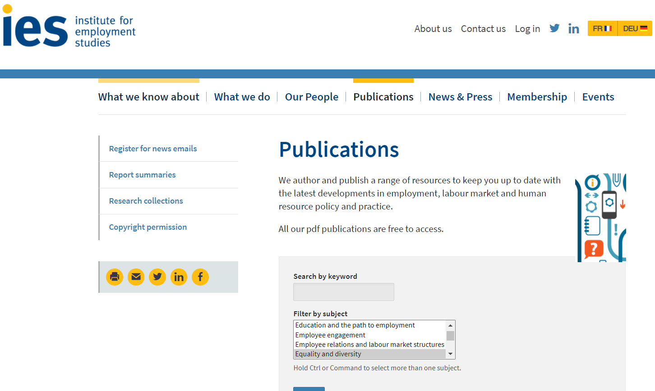
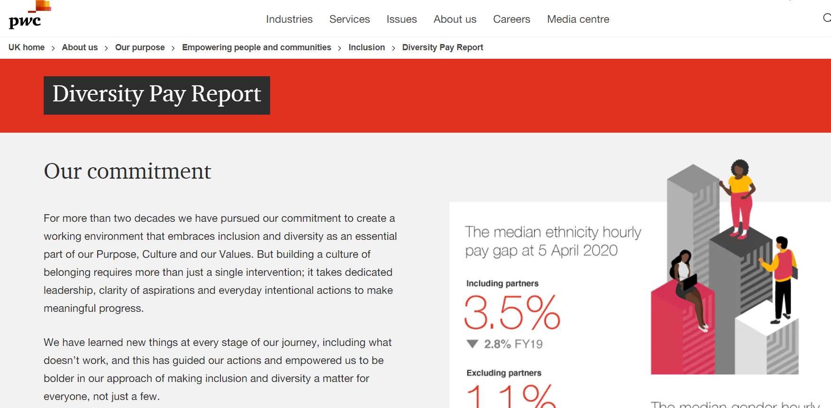
Resources
IES
https://www.employment-studies.co.uk/publications?search=&topic_tag%5B%5D=40&search_resources=1#results
EHRC
https://www.equalityhumanrights.com/en/our-research/list-all-our-research-reports
https://www.equalityhumanrights.com/en/publication-download/measuring-and-reporting-disability-and-ethnicity-pay-gaps
CIPD
https://www.cipd.co.uk/knowledge/fundamentals/relations/diversity/race-inclusion-reports#gref
https://www.cipd.co.uk/knowledge/tackling-racism-workplace#gref
https://www.cipd.co.uk/knowledge/tackling-racism-workplace/resource-pack-for-hr-leaders
ONS
https://www.ons.gov.uk/employmentandlabourmarket/peopleinwork/earningsandworkinghours/articles/ethnicitypaygapsingreatbritain/2019
Lots of examples e.g.
https://feweek-co-uk.cdn.ampproject.org/c/s/feweek.co.uk/2021/05/28/colleges-publish-ethnicity-pay-data-in-bid-to-increase-diversity/amp/

Slide 23


Thanks!
Duncan is an independent adviser and researcher on reward and equality and a principal associate at IES. He has worked at major HR consultancies and research. institutes including Aon and Willis Towers Watson. He was Deputy CEO at CIPD for 5 years.
Duncan’s clients have included Shell, Novartis and Lloyds Banking Group, the Cabinet Office and NHS Employers, The UN and Unicef UK.
He has advised government on a range of issues including pay determination for doctors and dentists, Armed Forces personnel and the judiciary. He was closely involved in developing the gender pay reporting regulations and also worked on the gender pay gap in medicine review.
Duncan is a leading commentator on HR and publishes and speaks widely. He is the joint author with Michael Armstrong of the UK’s best-selling Handbook of Reward Management. Human Resources magazine placed him in its listing of the top 5 most influential thinkers in UK HR.
Duncan has an MA from Cambridge University, an MBA from the London Business School, his PhD was in reward strategy and he is a Chartered Companion of the CIPD. He is a Visiting Professor at the University of Greenwich. He is a Board trustee at the High Pay Centre, Involvement and Participation Association and Pensions Policy Institute.
Email: duncanibrown54@gmail.com
Twitter: https://twitter.com/duncanbHR
Latest blog: https://www.employment-studies.co.uk/news/combating-inequality-2-budget-and-levelling-levelling-down-and-levelling
Latest article: https://www.linkedin.com/pulse/never-againso-what-could-new-normal-look-like-reward-employment/
Latest presentation: https://www.youtube.com/watch?v=74cimmL-iaI&feature=youtu.be
Recent book: https://www.koganpage.com/product/armstrong-s-handbook-of-reward-management-practice-9780749484361

