Slide 1




Working for the Future:
Commission on the Future of Employment Support
Tony Wilson, Institute for Employment Studies
tony.wilson@ies.ac.uk @tonywilsonIES

Slide 2
About the Commission
Established to develop evidence-led proposals for reform of our system of employment support and services
Defining employment support as public or publicly-funded services that:
Help people who want to move into work, stay in work or progress in work to do so
Help employers to find, recruit and retain the right people for their jobs
Looking at:
How support is organised at a UK level, within UK nations and locally
Role and function of Jobcentre Plus and of wider contracted or commissioned support
How employment is supported in wider public services like education, skills and health
Commission will run for around eighteen months, hosted by IES with funding and support from abrdn Financial Fairness Trust

Slide 3
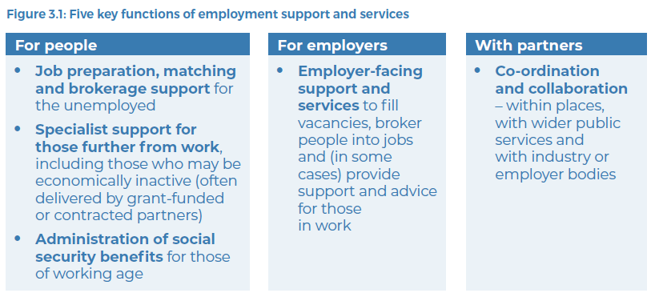

Slide 4
Ten commissioners from across employment support, public services, business and civil society
Commissioners
Ashwin Kumar – Professor of Social Policy; Manchester Metropolitan University
Carmen Watson – Chairperson, Pertemps Network Group
Fran Beasley – former Chief Executive, London Borough of Hillingdon
Karen Brookes – Director of People and Infrastructure, Sir Robert McAlpine
Kate Bell – Head of Rights, International, Social and Economics; Trades Union Congress
Kayley Hignell – Head of Policy (Families, Welfare and Work); Citizens Advice
Liz Sayce – Visiting Fellow, London School of Economics and Political Science
Michael Sheen – actor and producer
Mubin Haq – Chief Executive; abrdn Financial Fairness Trust
Neil Carberry – Chief Executive; Recruitment and Employment Confederation

Slide 5
Three phases:
Timing and process
Evidence gathering
To summer 2023
What are the issues, challenges and opportunities?
What’s working that we can build on?
What needs to change?
What can we learn from?
Exploring options
Second half of 2023
Options development – what could work?
Options appraisal – strengths, weaknesses, opportunities, threats?
Proposal design
Early 2024
Co-designed, evidence led, consensus based, costed proposal for future reform

Slide 6
Call for Evidence
Ran between November and January
95 responses, 249 pieces of evidence submitted
Initial summary at https://www.employment-studies.co.uk/resource/commission-future-employment-support
Questions in four areas – how support/ services:
Can work better for individuals, and particularly for those more disadvantaged in the labour market;
Can meet the needs of employers, both to fill their jobs and support good work;
Is organised and governed, including the role of the UK, devolved and local government and how services join up and work together locally; and
Can meet the needs of our future economy and society – supporting growth, economic change, an ageing population and the transition to net zero.

Slide 7
Support for individuals
Different approach to ‘work first’ – less focus on sanctions and compliance, more on relationships and support
Some support for a more ‘universal’/ entitlement based approach…
… alongside emphasis on need for more targeted support for particular, disadvantaged groups – including many not on benefits
Strong focus on importance of partnership working and joining up – health, housing, skills, careers services
Linking to an emphasis on local delivery, place-based approaches

Slide 8
Employer support
Viewed as complicated, fragmented, disjointed – need for more co-ordination
Preference again for a more localised approach…
… with a different approach to ‘work first’ – less push, more brokerage…
… and emphasis on working better with wider services like education, skills, careers, health
Support for greater joining up with wider business services
And better able to help with wider drivers of decent work – job design, workforce planning, (line) management, workplace support

Slide 9
Structure and governance
System is overly centralised and hard to navigate
Funding is piecemeal and too short term
General support for greater devolution – of funding, design, management
Some discussion of challenges with this – capacity, capability, consistency
Support for specialist, commissioned provision for more disadvantaged groups…
… But view that ‘DWP’ provision can be too large scale to join up effectively locally, too centralised, and too focused on ‘any job’
Widespread concern around extent and use of conditionality
Many respondents supported a greater (or complete) separation between benefits oversight and employment support

Slide 10
Future needs and opportunities
Jobs are changing: need to develop pathways for new jobs – digital, Net Zero
Labour force is changing: need to raise participation among older people, those who are more disadvantaged
But many respondents were more immediately and practically focused:
Improve access to in-work support, address working poverty
Support people who want to start or grow their own businesses
Harness the benefits/ mitigate risks of digital service delivery

Slide 11
Over to you!
Feedback on the findings first
Anything missing?
Anything that stands out?

Slide 12
Working for the Future:
Commission on the Future of Employment Support
Tony Wilson, Institute for Employment Studies
tony.wilson@ies.ac.uk @tonywilsonIES

