Slide 1

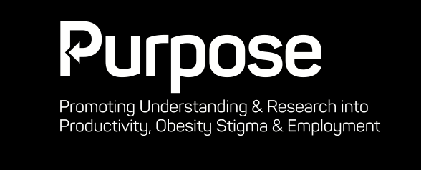

@DrZofia
Prepared for :
IES
Institute of
Employment Studies
Novo Nordisk has provided funding to the Institute for Employment Studies (IES) to undertake the creation of the PURPOSE programme, including the creation, development and delivery of this webinar. Novo Nordisk has had no influence over the planning or agenda for this webinar or this programme.
IES retains full and final editorial control over this webinar and all aspects of the PURPOSE programme.

Slide 2
Presentation outline
Introduction to Purpose
What is obesity?
Causes of weight-based stigma and it’s prevalence
Weight-based stigma and the employment cycle

Slide 3
Why Purpose? Why now?
“Being fat isn’t a birth defect. Nobody comes out of the womb needing to buy two seats on the plane. We have gone to this weird place where fat is good…Fat shaming doesn’t need to end; it needs to make a comeback. Some amount of shame is good.” (Bill Maher)
In response James Corden replied:
“Fat shaming never went anywhere. I mean, literally ask any fat person. We are reminded of it all the time.”

Slide 4
Why purpose? Why now?
The need to ‘frame the debate’ about obesity, stigma, discrimination and employment
Provide a clear evidence base about it’s prevalence in the UK
Move the dial from analysis to action

Slide 5
What is obesity?
Overweight and obesity is “an abnormal or excessive fat accumulation that may impair health” (WHO, 2016)
Usually classified by the BMI measure
Should obesity be classified as a disease in the UK?
Comorbidities

Slide 6
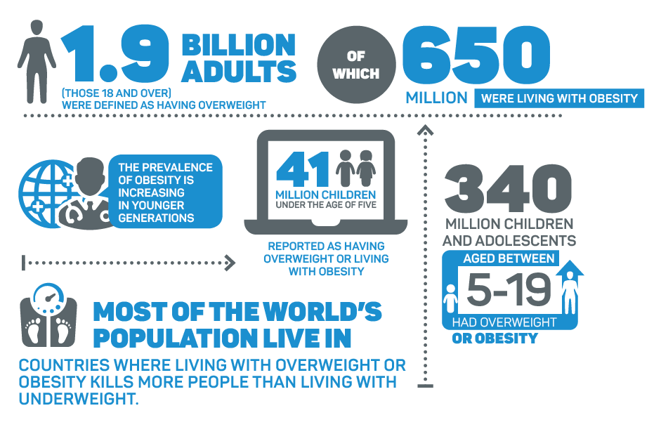
What is obesity?

Slide 7
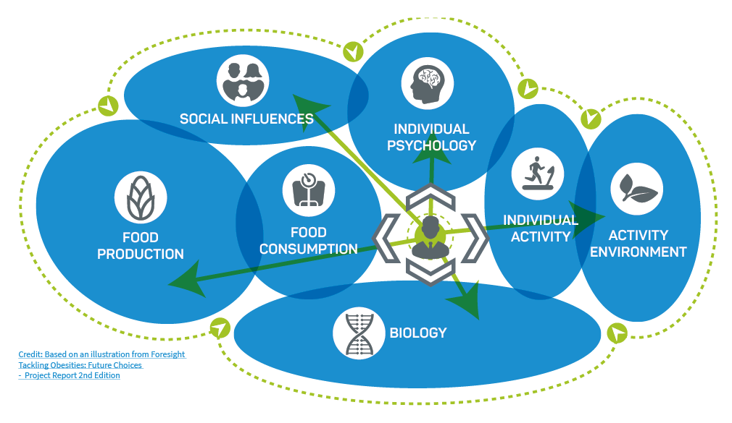
What is obesity?

Slide 8
Obesity and employment
Could the way that work is designed and conducted have an impact on obesity?
- The research indicates…YES!
Nature of shift work
Hours which people work
The psychosocial work environment
Sedentary work (jury is still out on this one)

Slide 9
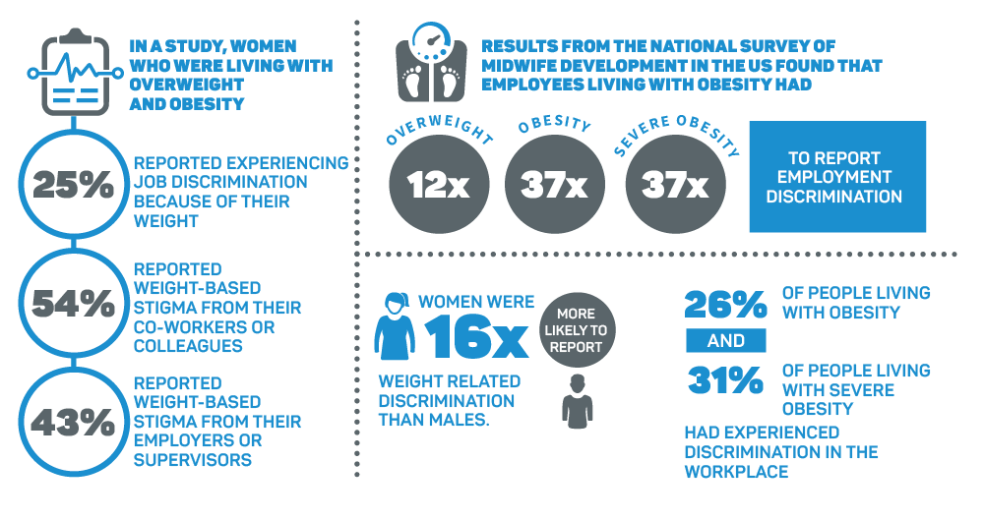
Weight-Based stigma and employment

Slide 10
Weight-Based stigma and employment
Weight-based stigma in employment is pervasive and there is research suggesting that this happens at every stage of the employment cycle:
  Recruitment and selection
  Developing employee relationships and wellbeing
  Progression and promotion
  Employment retention
  Unemployment

Slide 11
The obesity wage penalty
Overwhelming evidence that the wage penalty affects women far more than men – some estimate the gap to be up to 20% with an average of 9-13%
Not just annual earning – strong evidence of a life-course impact from childhood to adulthood
Women living with obesity at 16 have 34% lower household incomes at the age of 42

Slide 12
Reducing stigma – Key actors
Government
Employers
Healthcare professionals
Media
Employees

Slide 13
“There’s a common misconception that fat people are stupid and lazy, and we’re not…While you’re encouraging people to think about what goes into mouths, just think a little harder about what comes out of yours.”
(James Cordon)

Slide 14

Further information
For more information, feel free to email me at:
  zofia.bajorek@employment-studies.co.uk
Follow me on
  @DrZofia @EmploymtStudies
Or visit the IES website:
  https://www.employment-studies.co.uk/

