Slide 1
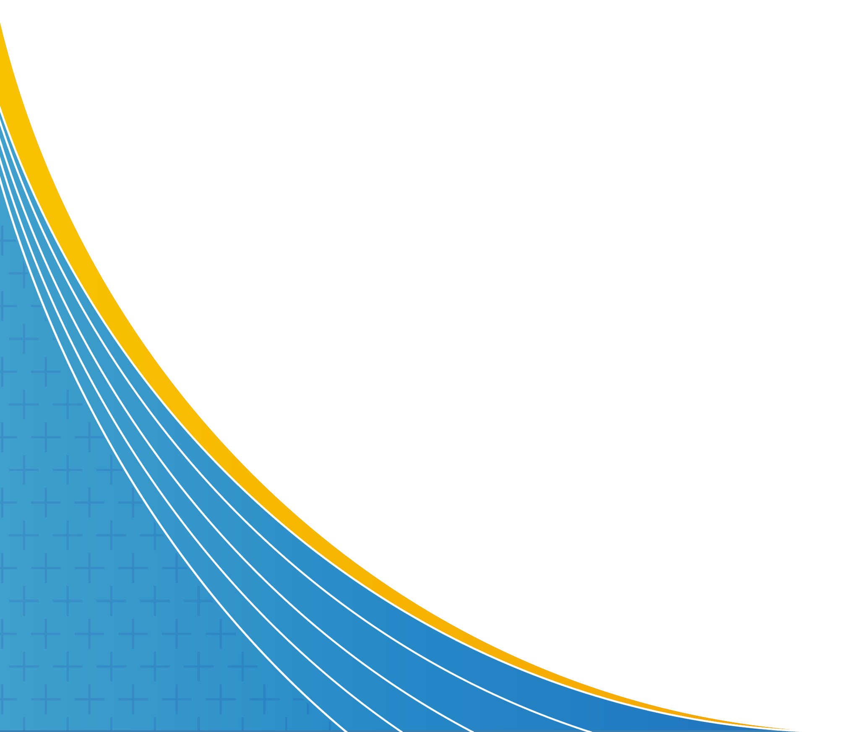


Worklessness due to Ill-Health
Towards more personalised & evidence-based interventions
Stephen Bevan
Institute for Employment Studies

Slide 2
Economic Inactivity & Long-term Illness
From data to people – some vignettes
Clinical & non-clinical determinants of inactivity
Who are the experts here – and are we making best use of them?
Harnessing the best research to inform policy & practice

Slide 3

Jean is a 57-year-old legal assistant. She has severe osteoarthritis of the hip and has been on an NHS waiting list for surgery for two years. She lives with severe chronic pain and occasional bouts of depression. In 2021 she took advantage of pension freedoms to take 25% of her pension pot tax free and gave up work. She hopes to find part-time work once she's had surgery but, for now, considers herself unable to hold down a job..

Slide 4

Richard is a 42-year-old general labourer. He has a history of alcohol problems and anxiety. After short periods of homelessness, and a longer period of unemployment, Richard moved back in with his mother rent free. He's receiving treatment and claims he wants to go back to work in construction at some point, though his mother is not sure he is ready. He's claiming Universal Credit but has been sanctioned twice in the last two years.

Slide 5

Jackie is a 35-year-old local government worker. She received a diagnosis of multiple sclerosis at the age of 30 and, after coping well with treatment and work initially, is now experiencing fluctuating and sometimes distressing symptoms (eg incontinence and fatigue). She feels a burden to her colleagues and that she has exhausted the patience of her bosses. She plans to give up work completely in a few months and to do some volunteering when her health allows.

Slide 6
Why such a big rise in inactivity?
NHS Waiting Times
Long-COVID
Finances & Pensions
Complexity & Comorbidity
Employer Capability

Slide 7
Why such a big rise in inactivity?
NHS Waiting Times
Long-COVID
Finances & Pensions
Complexity & Comorbidity
Employer Capability
Waiting times for OA-related hip & knee replacements (at least a third of all patients are of working age)
Waiting times & self-referral options for physiotherapy
Waiting times for CBT
Intense & chronic pain can undermine work ability & resilience – also hard for employers to make effective adjustments
New service announced on Monday – 700 more Employment Advisors in IAPT services – 100k people will be seen each year
RTW advice for people who come off these waiting lists after treatment?

Slide 8
Why such a big rise in inactivity?
NHS Waiting Times
Long-COVID
Finances & Pensions
Complexity & Comorbidity
Employer Capability
About 2.3m people living with long COVID
46% have symptoms lasting over a year & 22% for more than 2 years
Just over 1 in 5 are unable to work & 45% have had to reduce their hours – may make up 20% of those inactive?
Long COVID has many symptoms experienced in different ways by each individual. Diagnostic criteria still emerging and impact on work ability still being assessed.
Makes intervention complex – JR & RTW protocols are still emerging
May be a ‘long latency’ problem?
Good SOM Guidance material

Slide 9
Why such a big rise in inactivity?
NHS Waiting Times
Long-COVID
Finances & Pensions
Complexity & Comorbidity
Employer Capability
Only a minority of those inactive because of ill-health are on benefits
Some clear pockets of early retirement among some professionals whose pensions disincentivise work (eg some GPs and some HE staff)
Other older workers have taken advantage of pensions freedoms (25% of ‘pot’ tax free) – may cushion a fall out of work for those with complex or chronic health problems

Slide 10
Why such a big rise in inactivity?
NHS Waiting Times
Long-COVID
Finances & Pensions
Complexity & Comorbidity
Employer Capability
About 735k of the 2.49m inactive through ill-health have more than one health condition (need to avoid diagnostic ‘silos’)
For example, chronic low back pain & depression
Bi-directional nature of some comorbidities mean that diagnosis is difficult, as are the pathways to JR & RTW
Can be difficult to modify work, redesign jobs, assess risk of exacerbating features of the work environment & target interventions
Depression, anxiety, fatigue & chronic pain add to the fluctuating nature of the functional or cognitive capacity impairment
Also a big risk of over-medicalising some conditions

Slide 11
Why such a big rise in inactivity?
NHS Waiting Times
Long-COVID
Finances & Pensions
Complexity & Comorbidity
Employer Capability
Very variable competence, confidence, resources & motivation to offer flexibility, work modifications, accommodations, access to self-management & ‘job-crafting’
Some prefer to use experts (such as OH) to optimise attendance & manage absence, but can miss out on risk assessment & prevention interventions
Complex and progressive cases can be frightening or frustrating for some employers – prefer to offer statutory minimum & then move to dismissal, severance or ill-health retirement
Are we able to satisfy the increased appetite for wellbeing interventions with enough evidence-based support?

Slide 12
Who are the Experts?
Experts in supported employment, disability management and case management (place then train, personalisation, dealing with multiple barriers, multi-agency coordination, smart use of Fidelity measures, learning communities)
Vocational rehabilitation specialists – multi-disciplinary efforts to support job retention, work modification and RTW (OTs, physios, clinical psychologists, OH professionals) – strong biopsychosocial focus
Occupational Health professionals – employed in a range of settings, variety of specialisms, medics & nurses – understand the work/health interface, impact of job demands, risk exposure etc
Contributions support: those out of work through illness/injury; those in work but struggling; those in work who are exposed to risk; those in work who need RTW support after illness or injury
BUT - are we commissioning these experts to deploy their skills at the right time, for the right groups, in the most advantageous way?

Slide 13
Making the best use of research
Understanding the limits to the biomedical model
Comorbidity & fluctuating conditions
Long COVID
Evidence-based workplace interventions – helping employers to be informed consumers
A modern public employment service where evidence crowds out dogma

Slide 14


About IES: The Institute for Employment Studies (IES) is an independent, apolitical, international centre of research and consultancy in public employment policy and HR management. It works closely with employers in all sectors, government departments, agencies, professional bodies and associations. IES is a focus of knowledge and practical experience in employment and training policy, the operation of labour markets, and HR planning and development. IES is a not-for-profit organisation. www.employment-studies.co.uk
Email Stephen.bevan@employment-studies.co.uk
Follow IES on Twitter @EmploymtStudies @stephenbevan and LinkedIn Institute for Employment Studies

