Slide 1
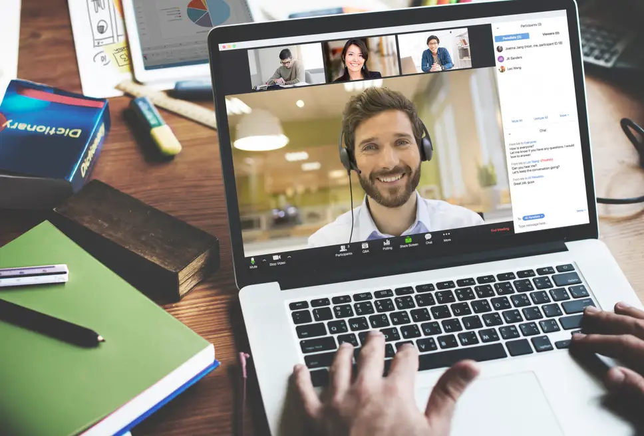

Survey Insights – changes 2020-21
By 2021 54% were working in an office for at least part of the week (25% in 2020)
Most aspects of physical & mental health had improved, though fatigue levels had increased
Most aspects of job satisfaction had increased – pride in employer, feeling trusted by boss
90% intended to stay for at least a year but 26% were considering early retirement in near future
Notes:
So what has this unique period in workplace history taught us? Well at the moment, and of course it is early days, some of the lessons seems to be:
Although there had previously been a lot of buy-in to the idea that outcome-based productivity was more effective than presence-based measures, lockdown provided the nudge to get many managers thinking more seriously about this. Within organisations there has been somewhat of a lack of routinely collected measurements of productivity, but with the shift towards job design being looked at on a more individual basis, there is an opportunity to factor this into good practice. (on a self-reported basis, at the two points at which we measured it, we found that 62% and 69% of workers felt more productive at home than in the office)
A second learning has been that offices that we have accepted for so long have not necessarily been configured in the most effective way for 21st C work. The lockdown has got organisations talking more about the connections between office and home life, so how the geography of workspace can complement environmental concerns, being well-connected to public transport, as well as how offices can be more energy efficient. Organisations were starting to rethink their occupancy of offices, whether they could become more shared spaces, as well as experimenting with hub-based working across multiple sites.
As organisations became aware of the impact which poor well-being could have on their efficiency during the pandemic, a very positive learning from lockdown can be to much more routinely support workforce well-being. The pandemic has raised some important flags around anxiety, fatigue and physical deteriorations, linked to the unusual situation, but also work intensification and heightened sedentary working practices during the pandemic. Many organisations are building into their recovery plan, different ways of supporting workforce well-being. In my own organisation, a university, there is a pilot for enable staff to break from their work to take 35 minutes of exercise a day, which thus far seems to be having positive effects upon well-being and productivity.
A really important learning from this intense period of enforced WfH has been around the way that teams have pulled together to make a success out of the unexpected situation, the result of which has been an increased trust between managers and staff that it is difficult to imagine being developed any other way. Managers often commented on the pride in their work displayed by their teams, the ways they went above and beyond to ensure that targets were met, and this has really shifted organisations’ expectations about how work has to be organised.
A final lesson has been that workforces need to know what their leaders are thinking and where they are going. Leaders needed to be visible, understood and trusted. Frequent and personalised communications by leaders was very much appreciated, with techniques like leader blogs, and pulse surveys being invaluable to check in with how employees were feeling. These will continue to be vital in the next big period of change. In these communications, language was important, for example, using phrasing like ‘back to work’ was felt to be unhelpful, and dismissive of the huge investments that staff had made into making a success out of pandemic working. There was a fine line to tread in providing leadership without being dictatorial, and retracting the autonomy that staff have so valued during the pandemic.

Slide 2

Post-lockdown work preferences
Permissiveness rather than diktat governs the process of agreeing hybrid working – half were allowed to agree terms directly with boss
A third are expected to attend for specific tasks/activities (team or customer events)
30% have full flexibility to WfH
25% can WfH on a fixed pattern
Only 12% have return to office mandated
Among employees whose work preferences are being met, morale, satisfaction & retention are highest
Notes:
So what has this unique period in workplace history taught us? Well at the moment, and of course it is early days, some of the lessons seems to be:
Although there had previously been a lot of buy-in to the idea that outcome-based productivity was more effective than presence-based measures, lockdown provided the nudge to get many managers thinking more seriously about this. Within organisations there has been somewhat of a lack of routinely collected measurements of productivity, but with the shift towards job design being looked at on a more individual basis, there is an opportunity to factor this into good practice. (on a self-reported basis, at the two points at which we measured it, we found that 62% and 69% of workers felt more productive at home than in the office)
A second learning has been that offices that we have accepted for so long have not necessarily been configured in the most effective way for 21st C work. The lockdown has got organisations talking more about the connections between office and home life, so how the geography of workspace can complement environmental concerns, being well-connected to public transport, as well as how offices can be more energy efficient. Organisations were starting to rethink their occupancy of offices, whether they could become more shared spaces, as well as experimenting with hub-based working across multiple sites.
As organisations became aware of the impact which poor well-being could have on their efficiency during the pandemic, a very positive learning from lockdown can be to much more routinely support workforce well-being. The pandemic has raised some important flags around anxiety, fatigue and physical deteriorations, linked to the unusual situation, but also work intensification and heightened sedentary working practices during the pandemic. Many organisations are building into their recovery plan, different ways of supporting workforce well-being. In my own organisation, a university, there is a pilot for enable staff to break from their work to take 35 minutes of exercise a day, which thus far seems to be having positive effects upon well-being and productivity.
A really important learning from this intense period of enforced WfH has been around the way that teams have pulled together to make a success out of the unexpected situation, the result of which has been an increased trust between managers and staff that it is difficult to imagine being developed any other way. Managers often commented on the pride in their work displayed by their teams, the ways they went above and beyond to ensure that targets were met, and this has really shifted organisations’ expectations about how work has to be organised.
A final lesson has been that workforces need to know what their leaders are thinking and where they are going. Leaders needed to be visible, understood and trusted. Frequent and personalised communications by leaders was very much appreciated, with techniques like leader blogs, and pulse surveys being invaluable to check in with how employees were feeling. These will continue to be vital in the next big period of change. In these communications, language was important, for example, using phrasing like ‘back to work’ was felt to be unhelpful, and dismissive of the huge investments that staff had made into making a success out of pandemic working. There was a fine line to tread in providing leadership without being dictatorial, and retracting the autonomy that staff have so valued during the pandemic.

