Slide 1


Slide 2
Ten commissioners from across employment support, public services, business and civil society
Commissioners
Fran Beasley – former Chief Executive, London Borough of Hillingdon
Kate Bell – Assistant General Secretary, Trades Union Congress
Karen Brookes – Chief People Officer, Sir Robert McAlpine
Neil Carberry – Chief Executive; Recruitment and Employment Confederation
Mubin Haq – Chief Executive; abrdn Financial Fairness Trust
Kayley Hignell – Head of Policy (Families, Welfare and Work); Citizens Advice
Ashwin Kumar – Director of Research and Policy, IPPR
Liz Sayce – Visiting Fellow, London School of Economics and Political Science
Michael Sheen – actor and producer
Carmen Watson – Chairperson, Pertemps Network Group

Slide 3
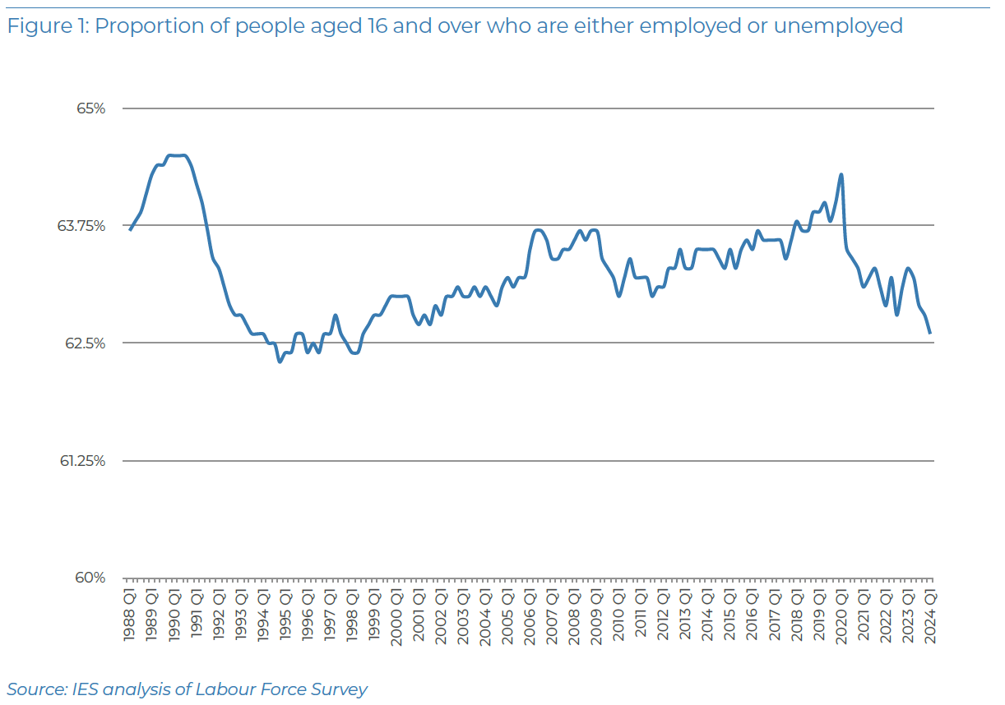
Lowest ‘participation rate’ in a generation – and most prolonged contraction since early 1990s…
The case for reform (1)

Slide 4
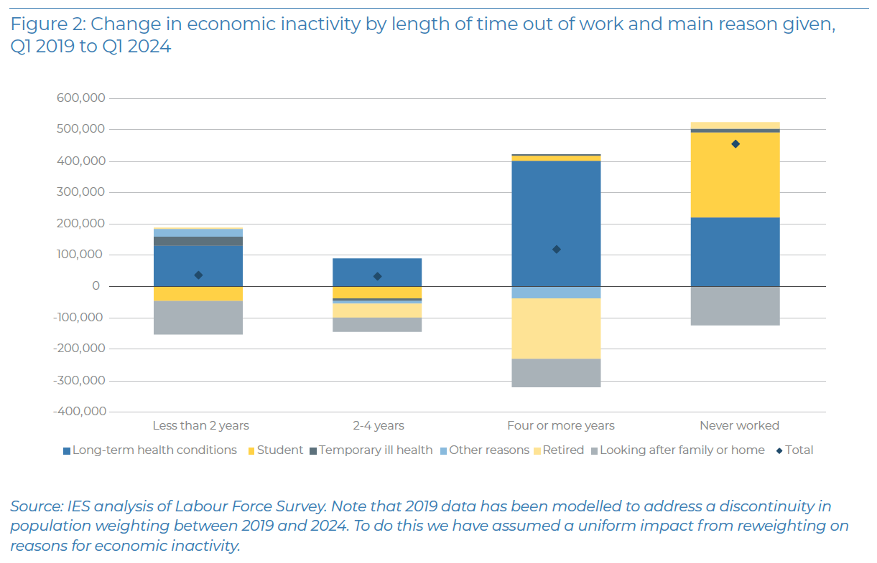

Vast majority of growth in worklessness since 2019 explained by people who last worked before Covid-19 or have never worked – not by recent exits
The case for reform (2)

Slide 5
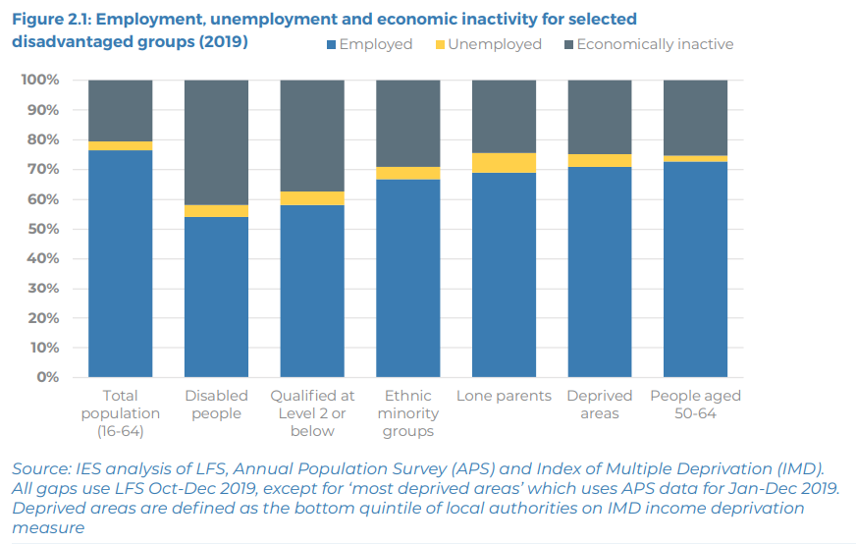
Even before the pandemic we had really significant inequalities in the labour market
The case for reform (3)

Slide 6
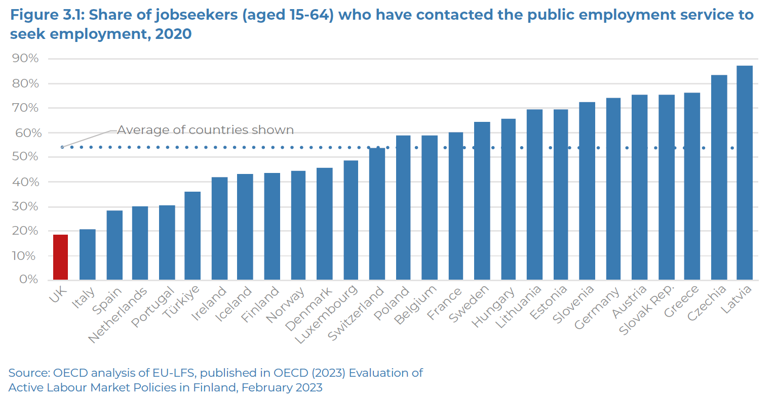
We have the least well-used employment service in Europe – just one in five jobseekers
The case for reform (4)

Slide 7
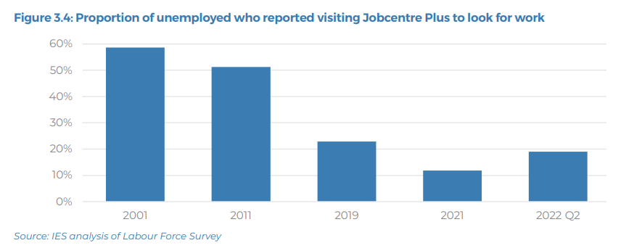
That’s not always been the case
The case for reform (4½)

Slide 8
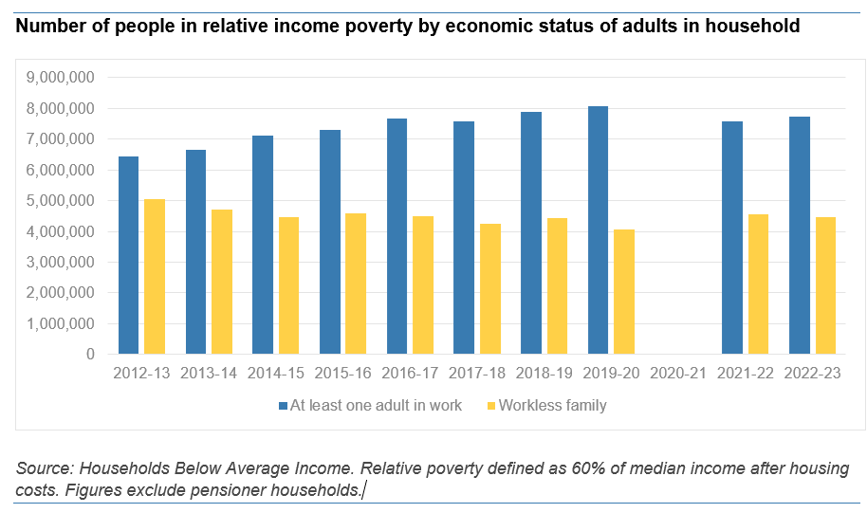
Work is not a route out of poverty – Two thirds of all poverty in households where someone works
The case for reform (5)

Slide 9
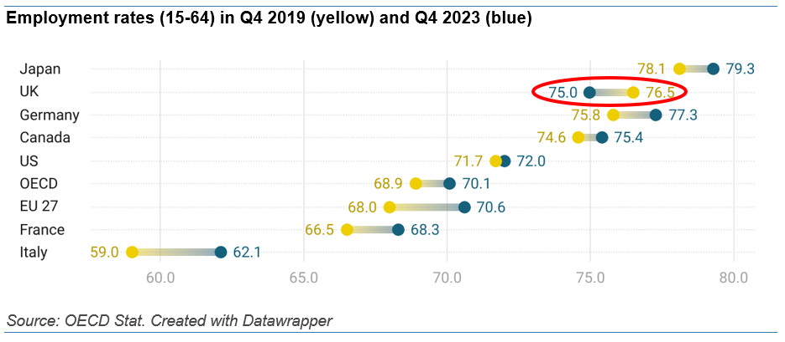
This just isn’t happening in other countries
The case for reform (6)

Slide 10
Economic, fiscal and social consequences
The costs of these failures are immense
Focusing just on the fiscal impacts, had we maintained our position relative to others – as seventh highest employment in Europe – the public finances would be at least £16 billion a year stronger
The economy would be at least £25 billion a year bigger
The size of the prize is therefore also significant, even with modest improvements
Reaching just 5% more people with employment support, and helping just 3% more to get into work or get on in work, would save the Exchequer at least £300m a year and boost growth by at least £750m a year

Slide 11
Since our launch in November 2022, we’ve:
Why is this happening and what can we do?
Run a Call for Evidence, with nearly 100 responses and around 250 pieces of evidence
Held twenty consultation events (workshops, webinars, expert evidence sessions and focus groups) hearing from over a hundred people with professional expertise and/ or experience of using services to look for work or to fill jobs
Conducted an extensive evidence and literature review, from the UK and overseas
Heard directly from people in national and local governments (across all four UK nations); people working in employment services; large and small employers and representatives; colleges and training providers; careers services; social landlords; people working in health services; academics and researchers; international experts; and service users
Polled the public and employers on their experiences and views on support
Run nine design workshops to explore and develop potential solutions – with service users, policymakers and delivery organisations
Held over a dozen roundtables and workshops to finalise proposals (engaging around 100 experts and stakeholders)
Key outputs – launch report, summary of call for evidence, interim report, final report – all available at https://www.employment-studies.co.uk/commission

Slide 12
Challenges across how we work with people, employers and partners
What’s not working
Supporting people
Narrow focus of support; ‘any job’ mindset; punitive approach; lack of effective co-ordination with wider services
Disempowering jobseekers, discouraging people from accessing support, alienating partners and employers
Working with employers
We don’t, generally… ‘Goods-led’ approach; narrow offer; poor alignment with wider services; low engagement
Partnership working
Little/ no infrastructure to support this; little or no autonomy for Jobcentre Plus; short-termism and siloed thinking makes things harder
Where things work better, it’s often in spite of these constraints
Digital delivery
Has the potential to transform services, but under-invested in this in the UK – and risks we need to manage too

Slide 13
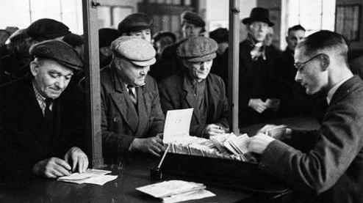

Slide 14
From this:
‘If [Iinterviewing Officers] were told to cease bothering about “where were you last Tuesday” and to devote themselves to finding out what they could do to help the claimant in his quest for work, they would throw themselves into the work with real enthusiasm. They would, moreover, develop a real facility for guiding and helping.’
‘Reflections on a Tour of Certain Employment Exchanges’ by John Hilton, Assistant Secretary at the Ministry of Labour, 1929

Slide 15
To this:
‘… the Employment Service is the single most important tool to ensure the proper functioning of the labour market and … has a crucial role to play in revitalising the British economy.’
‘Manpower Policies in the UK’, OECD, 1970

Slide 16
27 recommendations, but can be boiled down to four linked themes
Commission proposals
Jobs and Careers Service
Open to all, enabling and networked
Labour Market Partnerships
Empowered and accountable local partnerships: national and local govt, public services, social partners, employers
To develop local plans, join up across services, commission support, lead change
Ending the compliance culture
Online – digital employment service
On the high street – one-stop centres
On the doorstep – thru wider services
Single system for employers
New framework for a reformed system
Replace the 35 hour rule; reform approach for people in work or with limitations
Clearer separation between benefits administration and employment support
Reform/ replace Claimant Commitment
Clear objectives: employment growth, tackling poverty and insecurity, reducing inequalities
Underpinned by Guarantees of access to support, common standards across services
New role for central govt – stewardship, partnership, evidence, impact
Full devolution to Scotland and Wales, on same basis as Northern Ireland

Slide 17
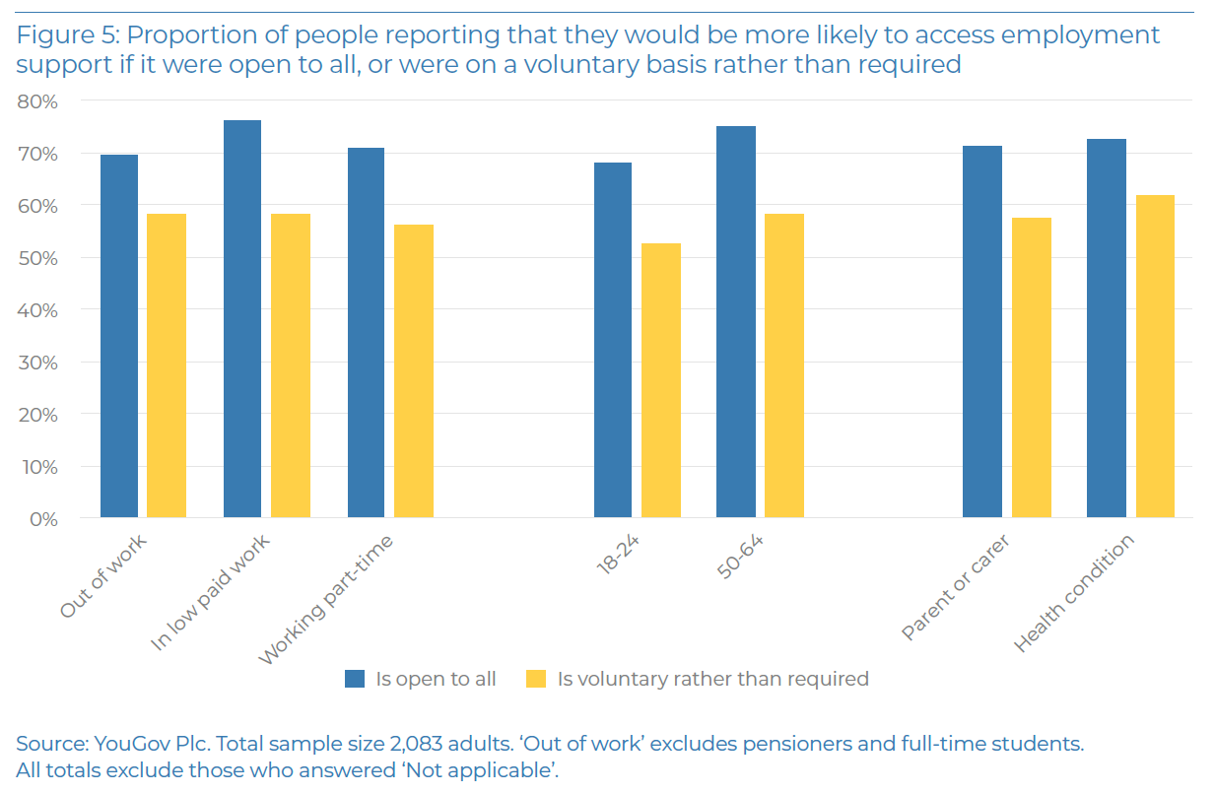
Older people, those with health conditions, in low paid work particularly likely to say they’d engage with support that is voluntary, open to all
This will widen access to support

Slide 18
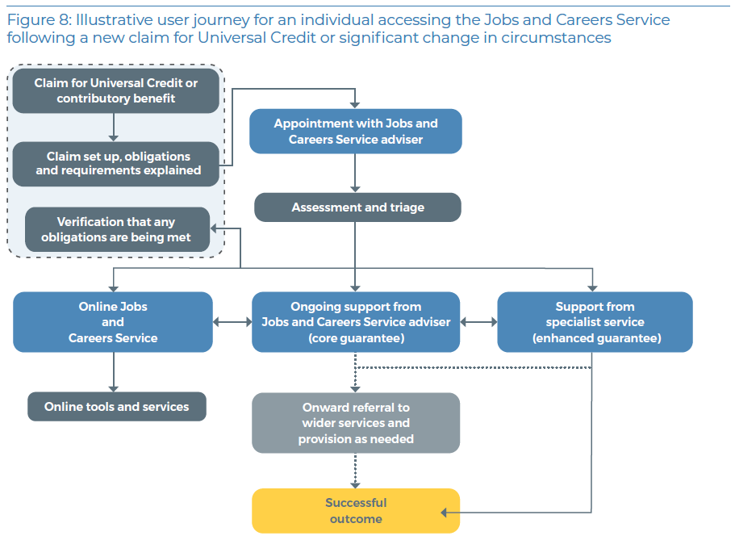
Joined up with, but separate from, benefits administration
The Jobs and Careers Service in practice

Slide 19
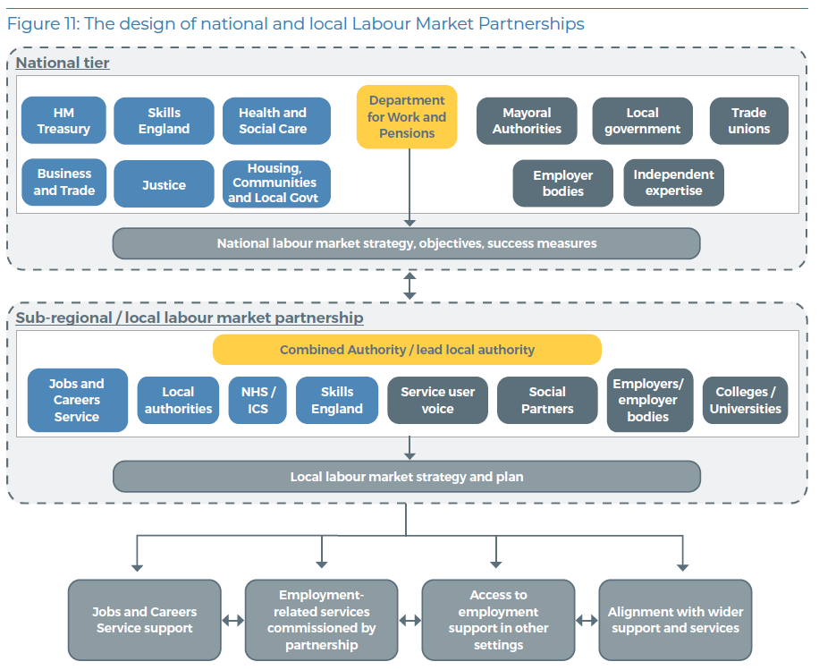
Whole system, with clear accountabilities and responsibilities
Labour Market partnerships

Slide 20
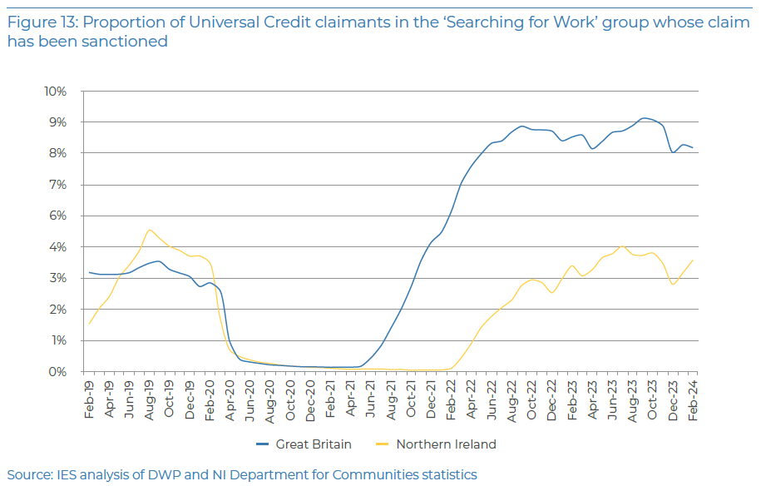
Northern Ireland has the same rules as GB, sanctions fewer than half as many jobseekers, and now has lowest claimant unemployment in the UK
On ‘conditionality’, how we work really matters

Slide 21
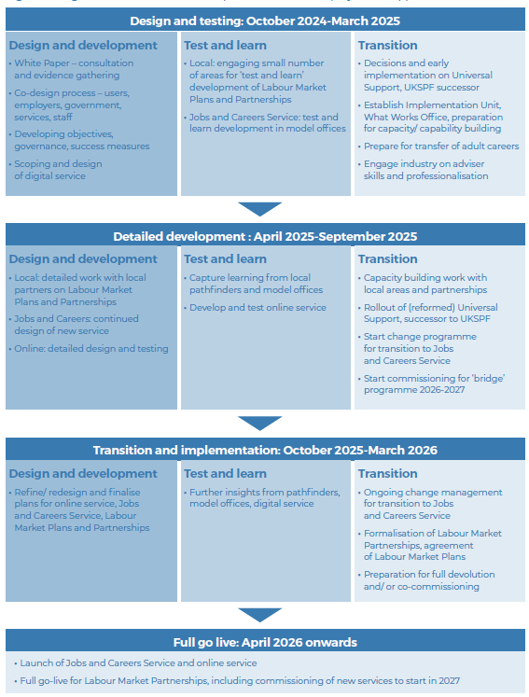
Roadmap to 2026

